Slide 1
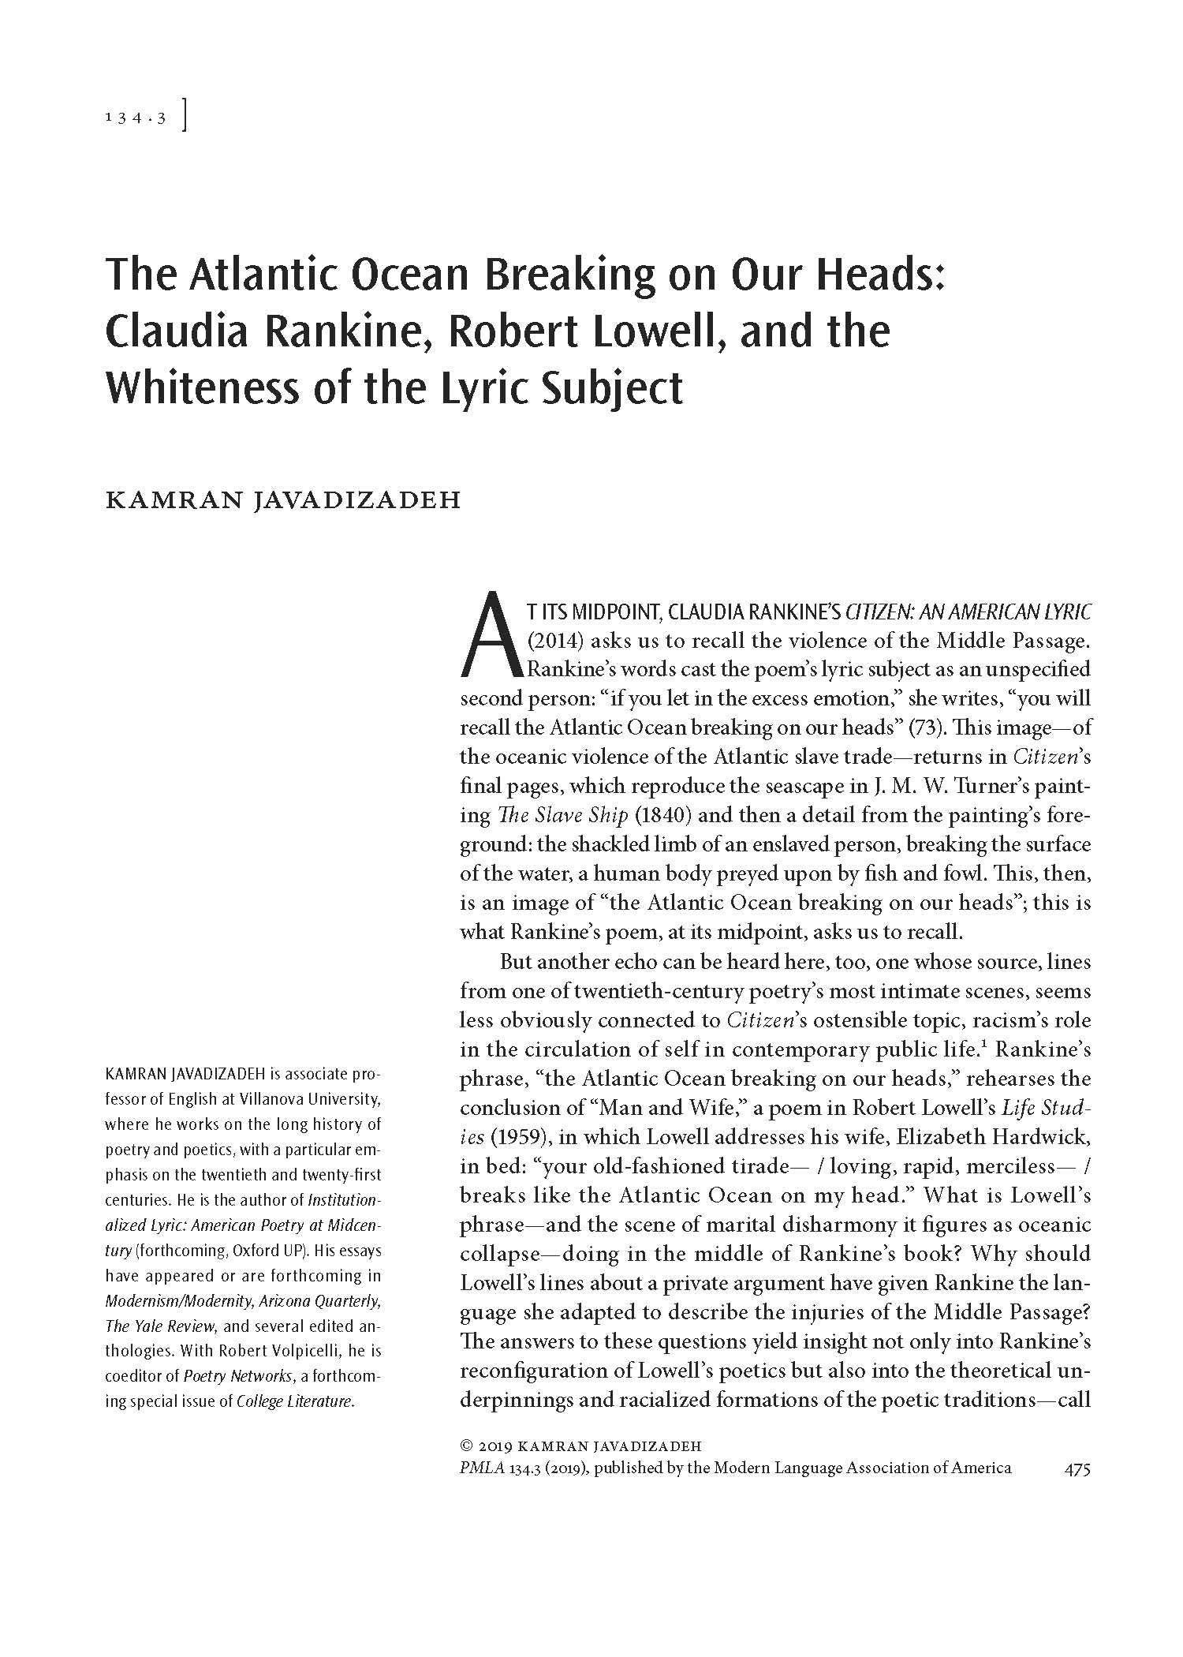
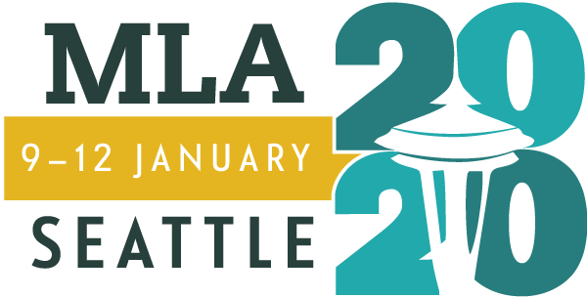
MLA Publication Prize Winners
56th Annual
William Riley Parker Prize

Slide 2
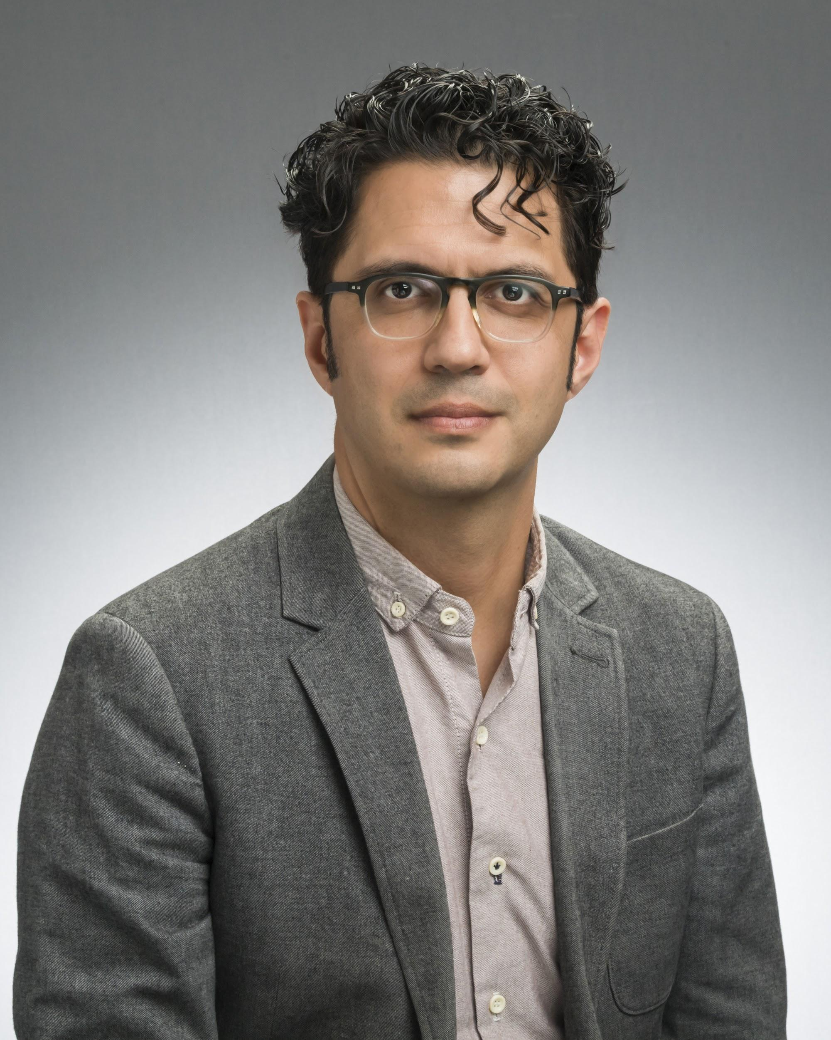
William Riley Parker Prize
Kamran Javadizadeh
“The Atlantic Ocean Breaking on Our Heads: Claudia Rankine, Robert Lowell, and the Whiteness of the Lyric Subject” (PMLA, May 2019)
I was surprised to learn just how precisely and profoundly Rankine’s intuition about Lowell’s poetry—that it evinced his struggle with the construction of whiteness—was borne out by what I found in the archive. I shouldn’t have been surprised; poetry, too, is a way of knowing.

Slide 3
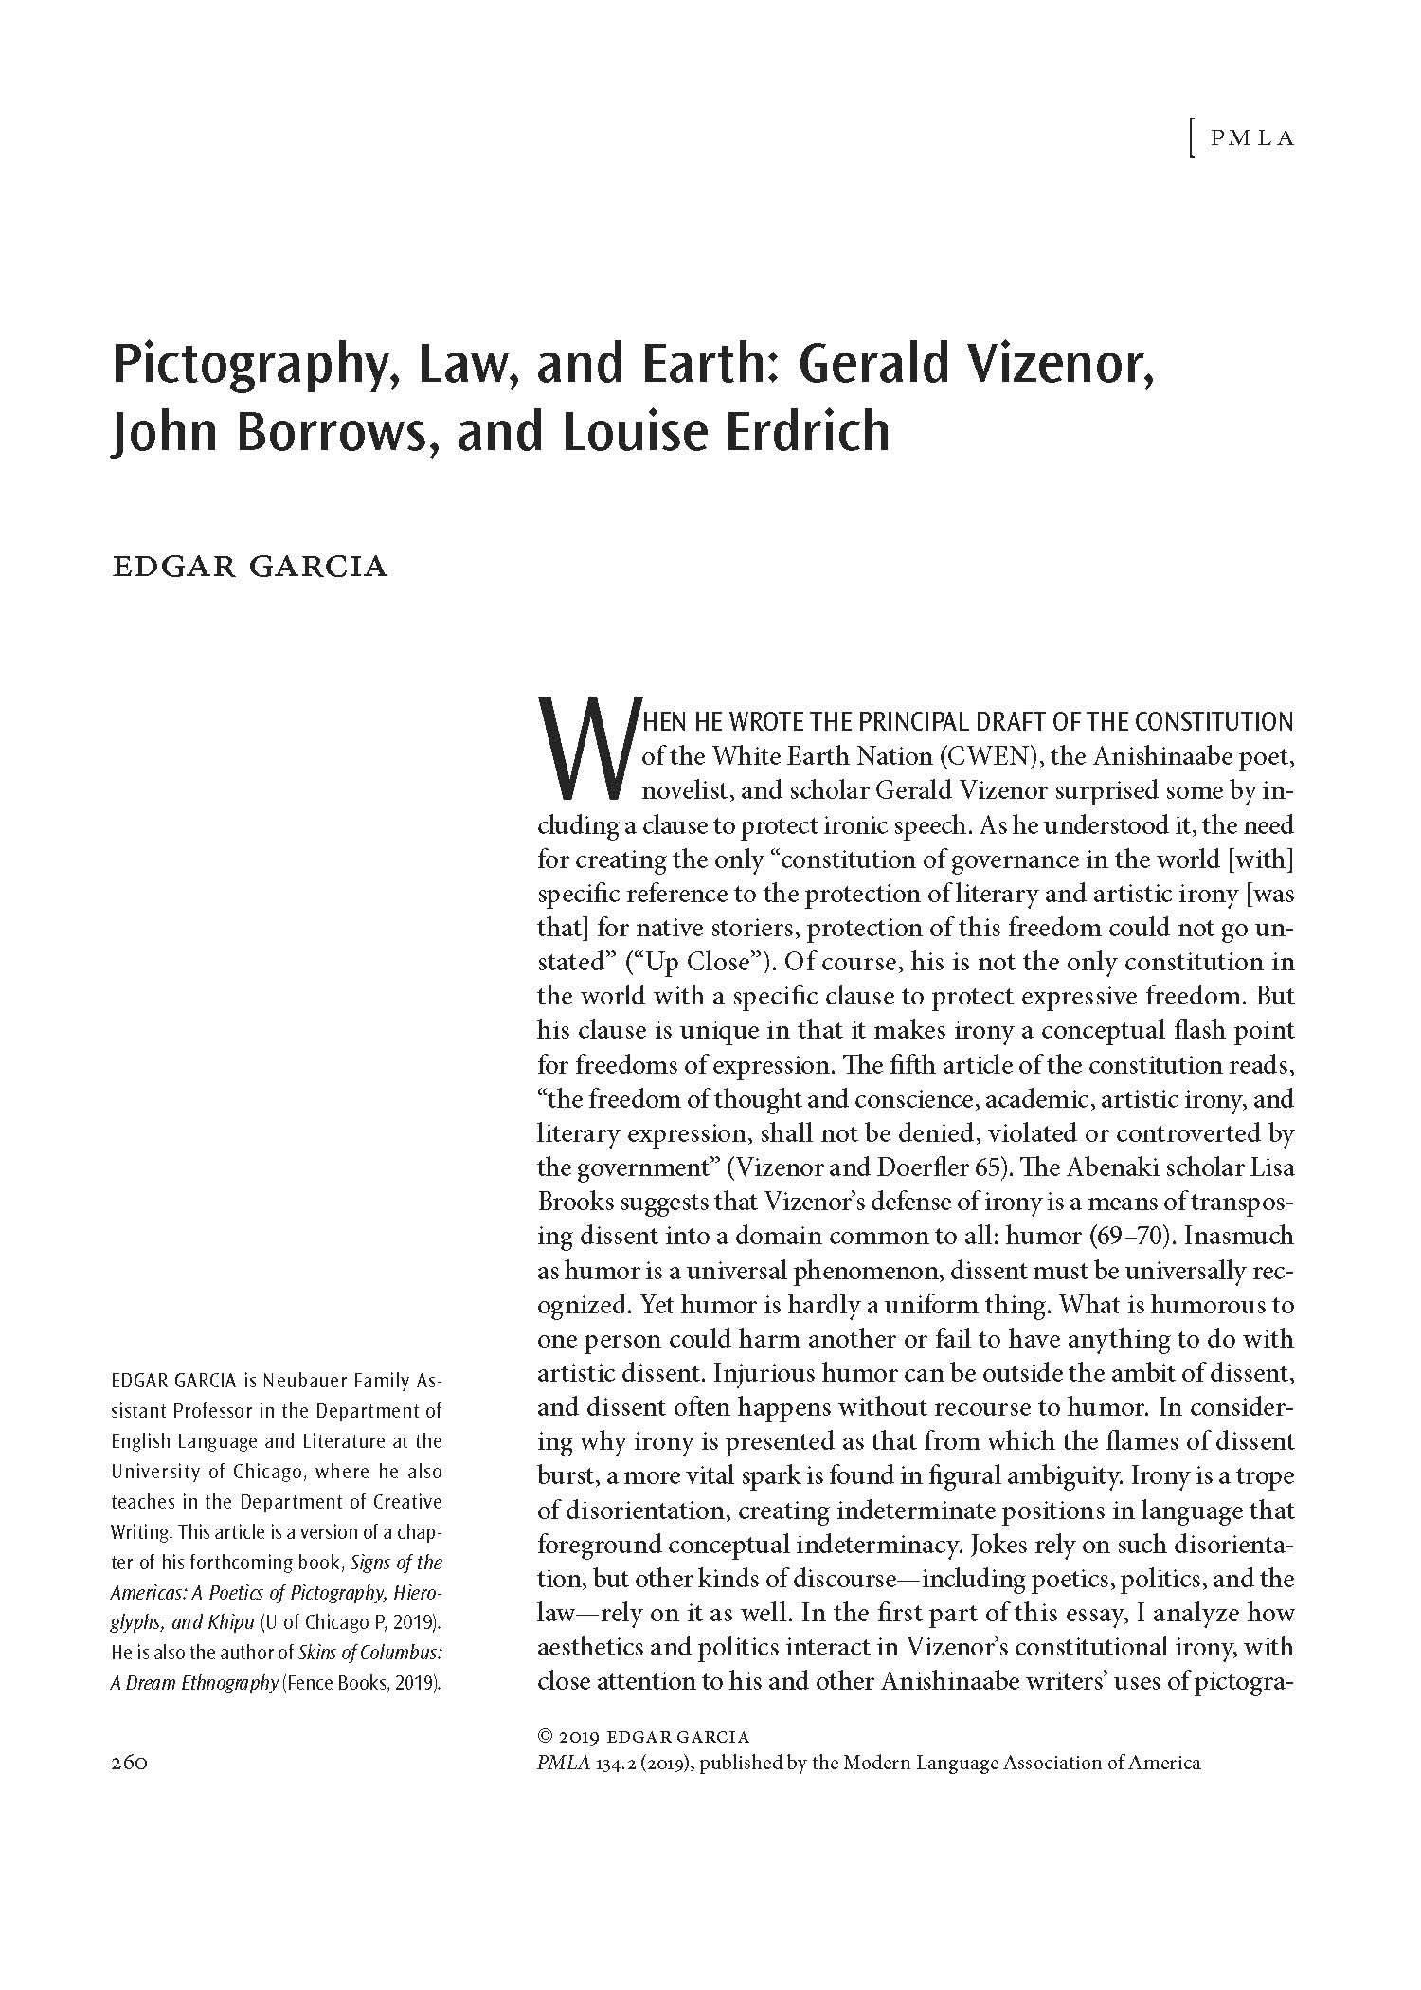
MLA Publication Prize Winners
56th Annual
William Riley Parker Prize
Honorable Mention

Slide 4
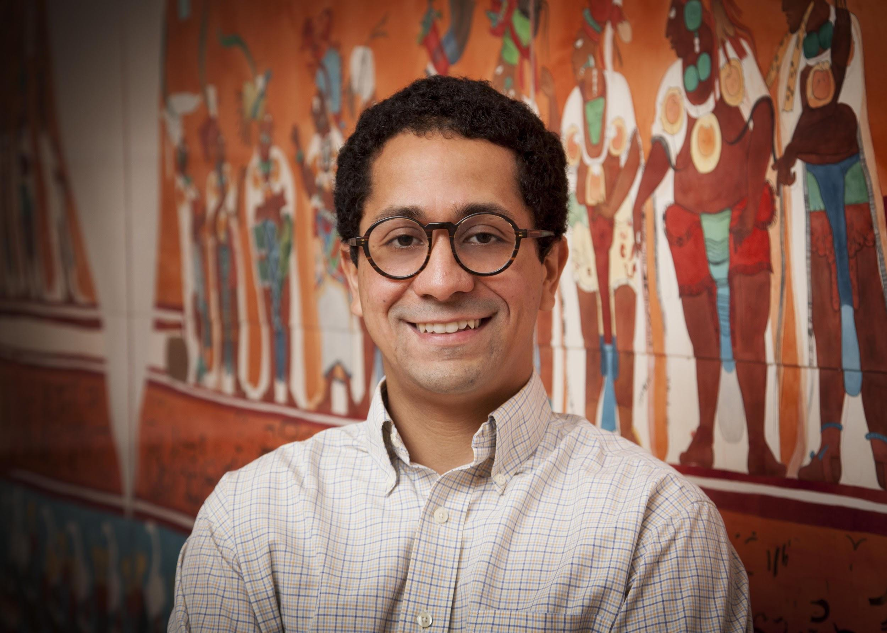
William Riley Parker Prize Honorable Mention
Edgar Garcia
“Pictography, Law, and Earth: Gerald Vizenor, John Borrows, and Louise Erdrich”
(PMLA, March 2019)
These indigenous sign systems and hemispheric cultural practices of the Americas have never been forgotten—but remain a dynamic part of contemporary writing, art, legal philosophy, political activism, and environmental thinking.

Slide 5
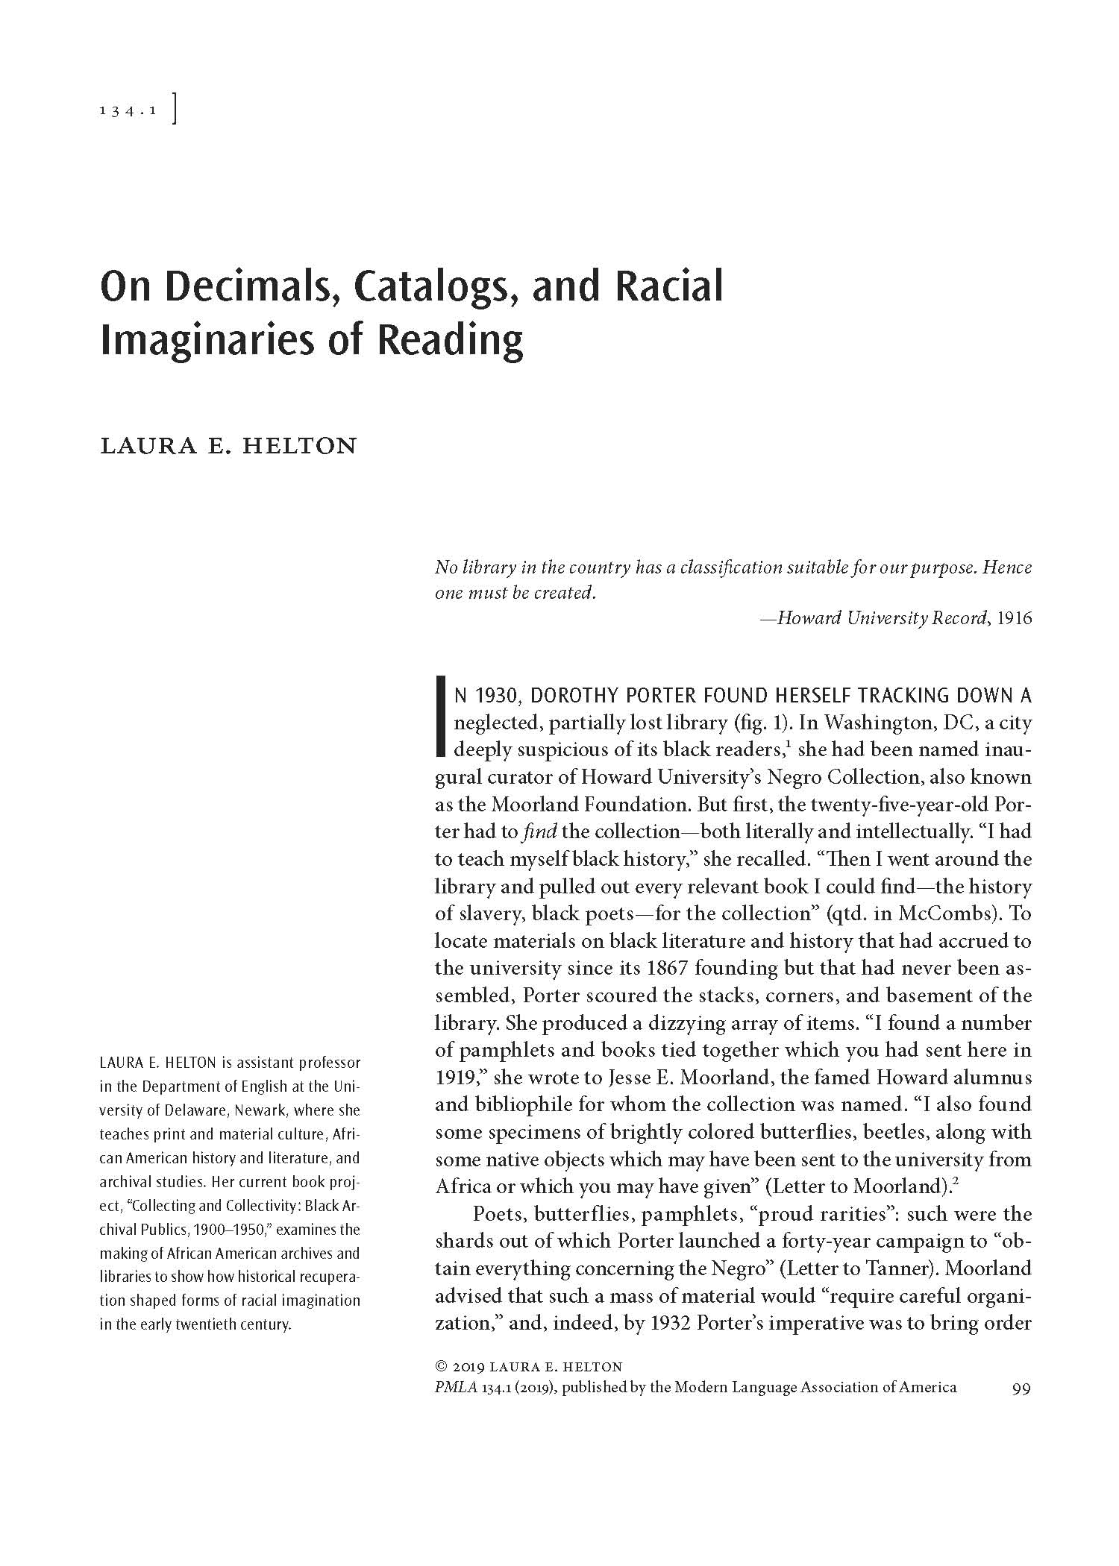
MLA Publication Prize Winners
56th Annual
William Riley Parker Prize
Honorable Mention

Slide 6

William Riley Parker Prize Honorable Mention
Laura E. Helton
“On Decimals, Catalogs, and Racial Imaginaries of Reading” (PMLA, January 2019)
As card catalogs become objects of nostalgia, we lose a century’s worth of literary practice that was often creatively and subversively filed away behind drawers labeled Aa-Ab, Ac-Af, Ag-Am. What would happen if we paused to consider the catalog as a site of both authorship and reading?

Slide 7
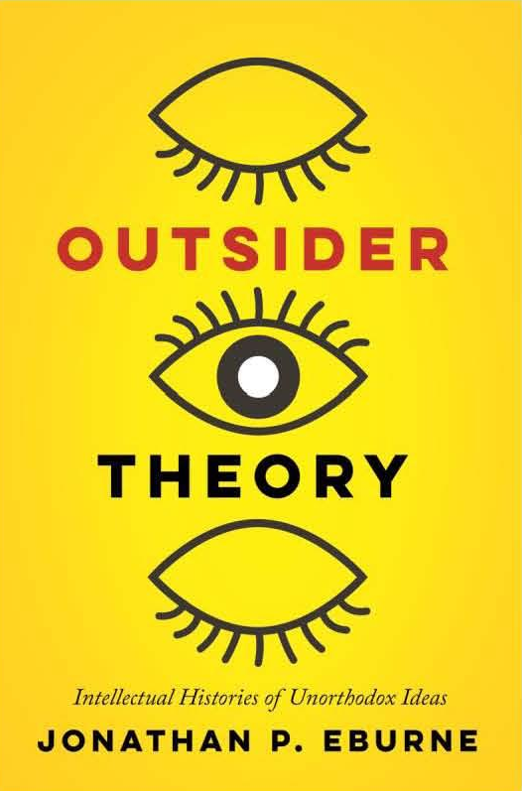
MLA Publication Prize Winners
50th Annual
James Russell Lowell Prize

Slide 8

James Russell Lowell Prize
Jonathan P. Eburne
Outsider Theory: Intellectual Histories of Unorthodox Ideas
As a bibliophile and near-hoarder of books, I wanted to gain a better understanding of the many secondhand books I have picked up over the course of my adult life and to consider what it means to consider their currency as thought.

Slide 9
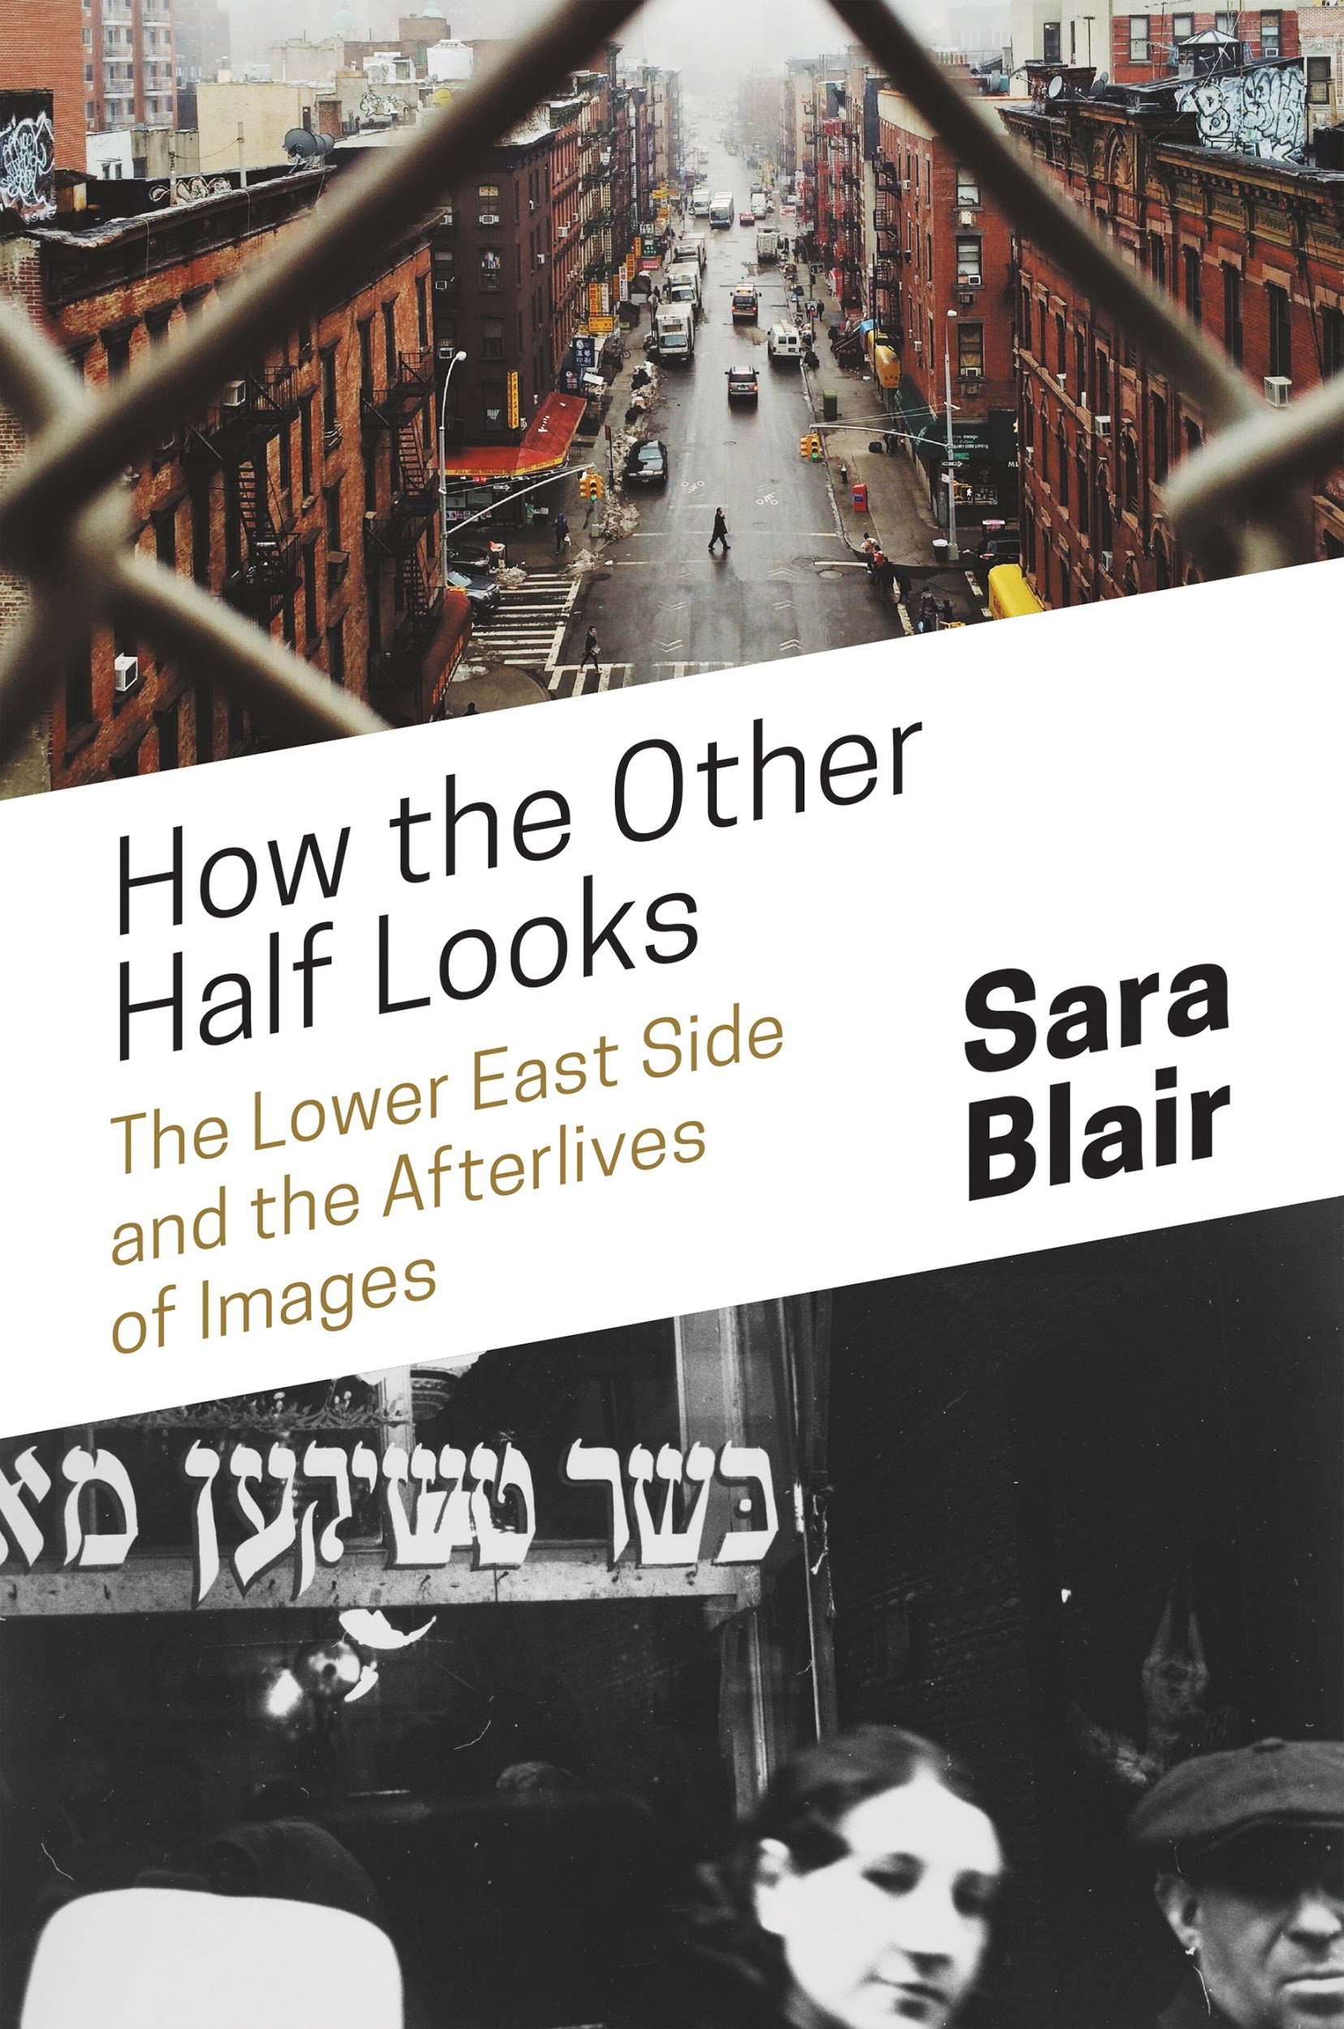
MLA Publication Prize Winners
50th Annual
James Russell Lowell Prize
Honorable Mention

Slide 10
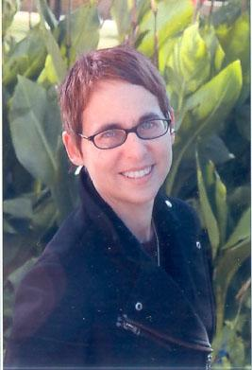
James Russell Lowell Prize Honorable Mention
Sara Blair
How the Other Half Looks: The Lower East Side and the Afterlives of Images
“Representations of the Lower East Side, visual and textual, historical and very recent, remind us how much cultural work we do to continue imagining the project of America, what it means to be or become an American and to have a collective future.”

Slide 11
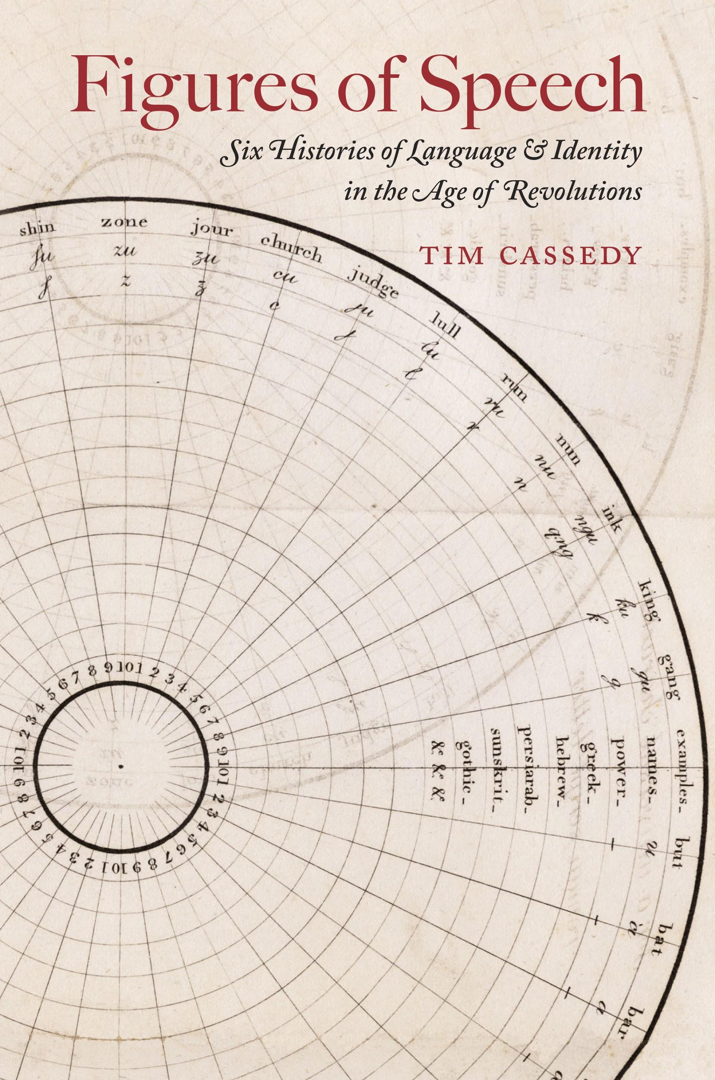
MLA Publication Prize Winners
26th Annual
MLA Prize for a
First Book

Slide 12

MLA Prize for a First Book
Tim Cassedy
Figures of Speech: Six Histories of Language and Identity in the Age of Revolutions
My research subjects undertook linguistic projects that now seem unthinkable: a talking clock that was never built, an expensive book that wasn’t even theoretically possible to read, and numerous small fortunes spent on experimental typography.

Slide 13

MLA Publication Prize Winners
26th Annual
MLA Prize for a
First Book
Honorable Mention

Slide 14
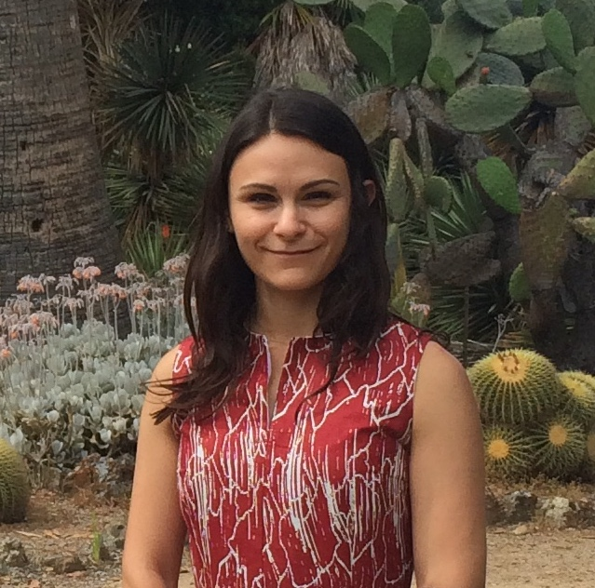
MLA Prize for a First Book Honorable Mention
Adena Spingarn
Uncle Tom: From Martyr to Traitor
When I read Uncle Tom’s Cabin for the first time, I was surprised to discover that the character of Uncle Tom was not the race traitor I expected he would be. When I couldn’t find a book or article to explain the change in meaning, I knew I’d found the subject of my first book.

Slide 15
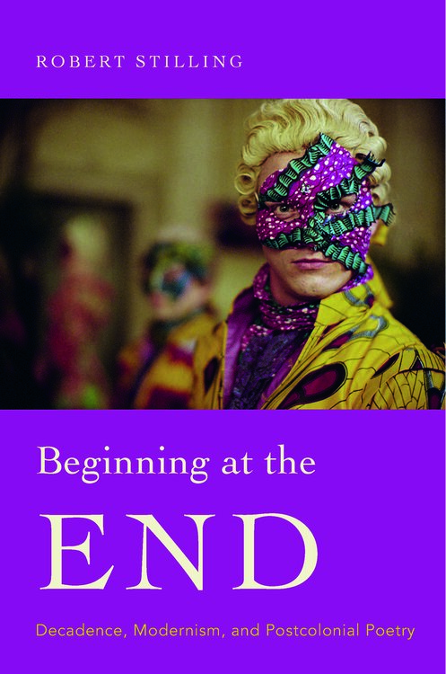
MLA Publication Prize Winners
26th Annual
MLA Prize for a
First Book
Honorable Mention

Slide 16
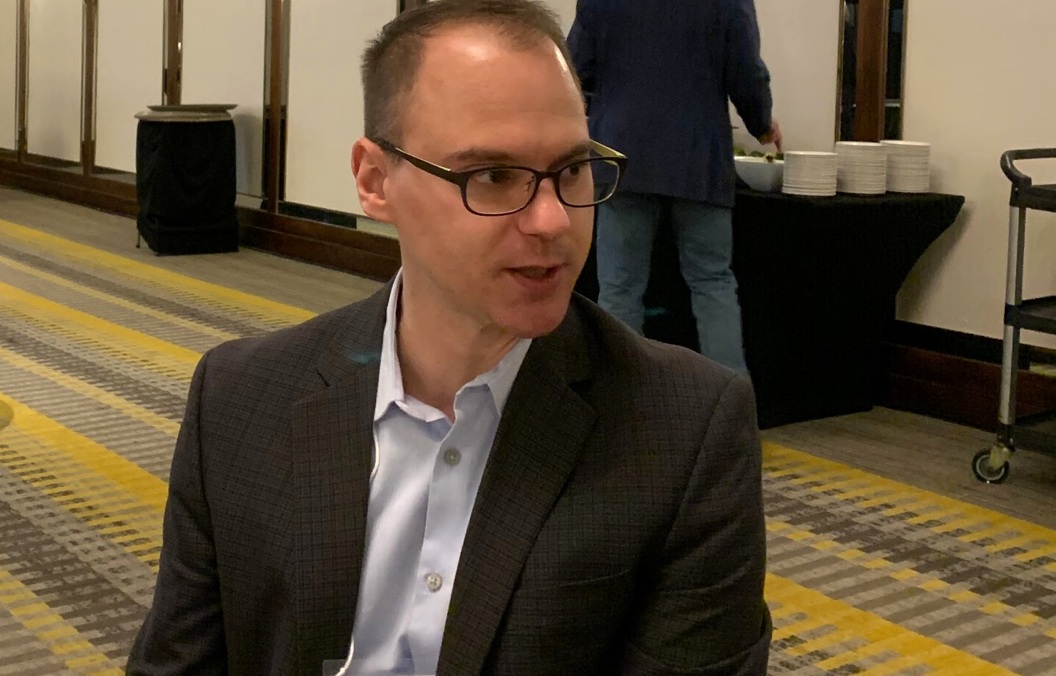
MLA Prize for a First Book Honorable Mention
Robert Stilling
Beginning at the End: Decadence, Modernism, and Postcolonial Poetry
Everything began for me with Agha Shahid Ali’s poem “The Dacca Gauzes,” which manages to capture the exquisite pleasures of Oscar Wilde’s aestheticism and the brutal colonial history behind it.
Photo TK

Slide 17
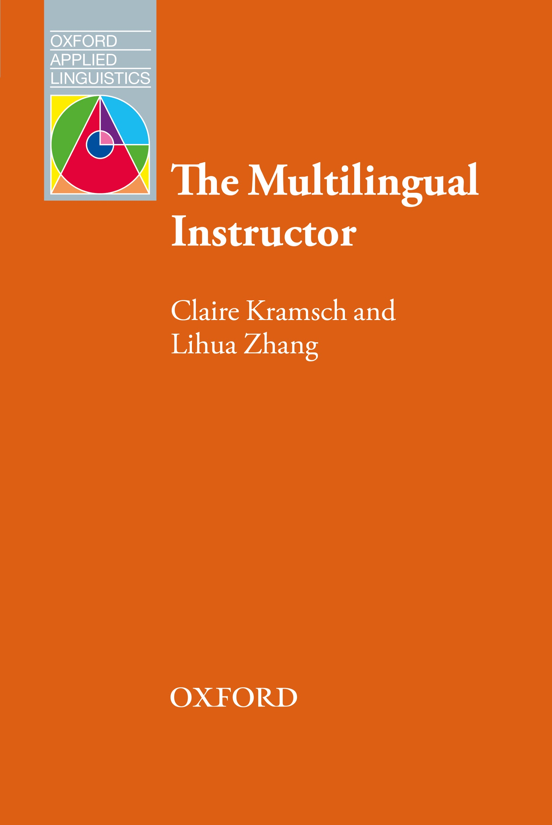
MLA Publication Prize Winners
35th Biennial
Kenneth W. Mildenberger Prize

Slide 18


Kenneth W. Mildenberger Prize
Claire Kramsch and Lihua Zhang
The Multilingual Instructor: What Foreign Language Teachers Say about Their Experience and Why It Matters
We found that foreign language teachers were much more modest in their professional vision than they have a right to be and that they have the power to change young adults’ ways of seeing and acting upon the world through the language they use.

Slide 19

MLA Publication Prize Winners
15th Biennial
Morton N. Cohen Award

Slide 20

Morton N. Cohen Award
Edward M. Burns
Questioning Minds: The Letters of Guy Davenport and Hugh Kenner, 2 volumes
The letters are written in an ecstatic volley that reveals the unending curiosity of two polymaths delighting in each other’s thoughts.
Photo Credit: Francine Lyshak

Slide 21
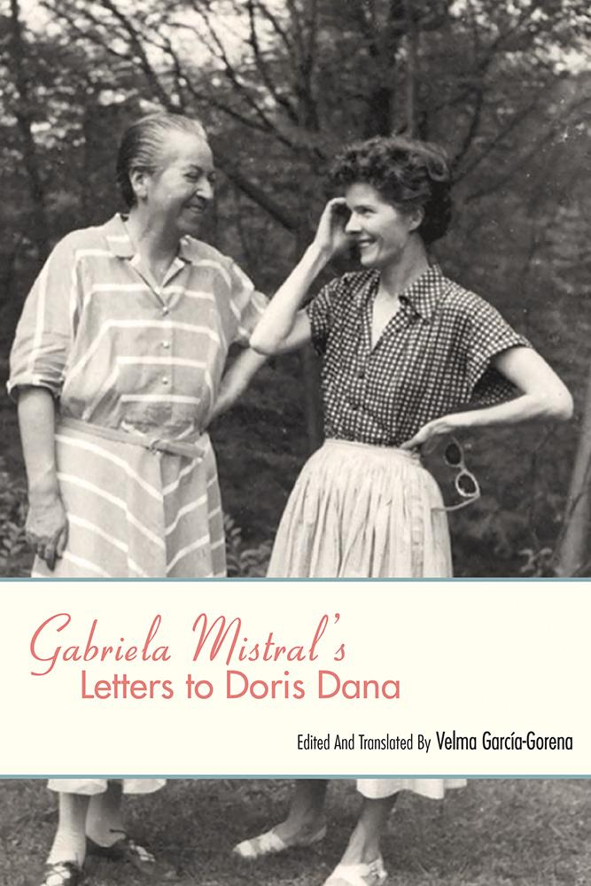
MLA Publication Prize Winners
15th Biennial
Morton N. Cohen Award
Honorable Mention

Slide 22

Morton N. Cohen Award Honorable Mention
Velma García-Gorena
Gabriela Mistral’s Letters to Doris Dana
I found the letters to be remarkably moving. Dana’s niece, Doris Atkinson, encouraged me to translate the correspondence in order to make the first Latin American Nobel Laureate’s life and words available to an English language audience.

Slide 23
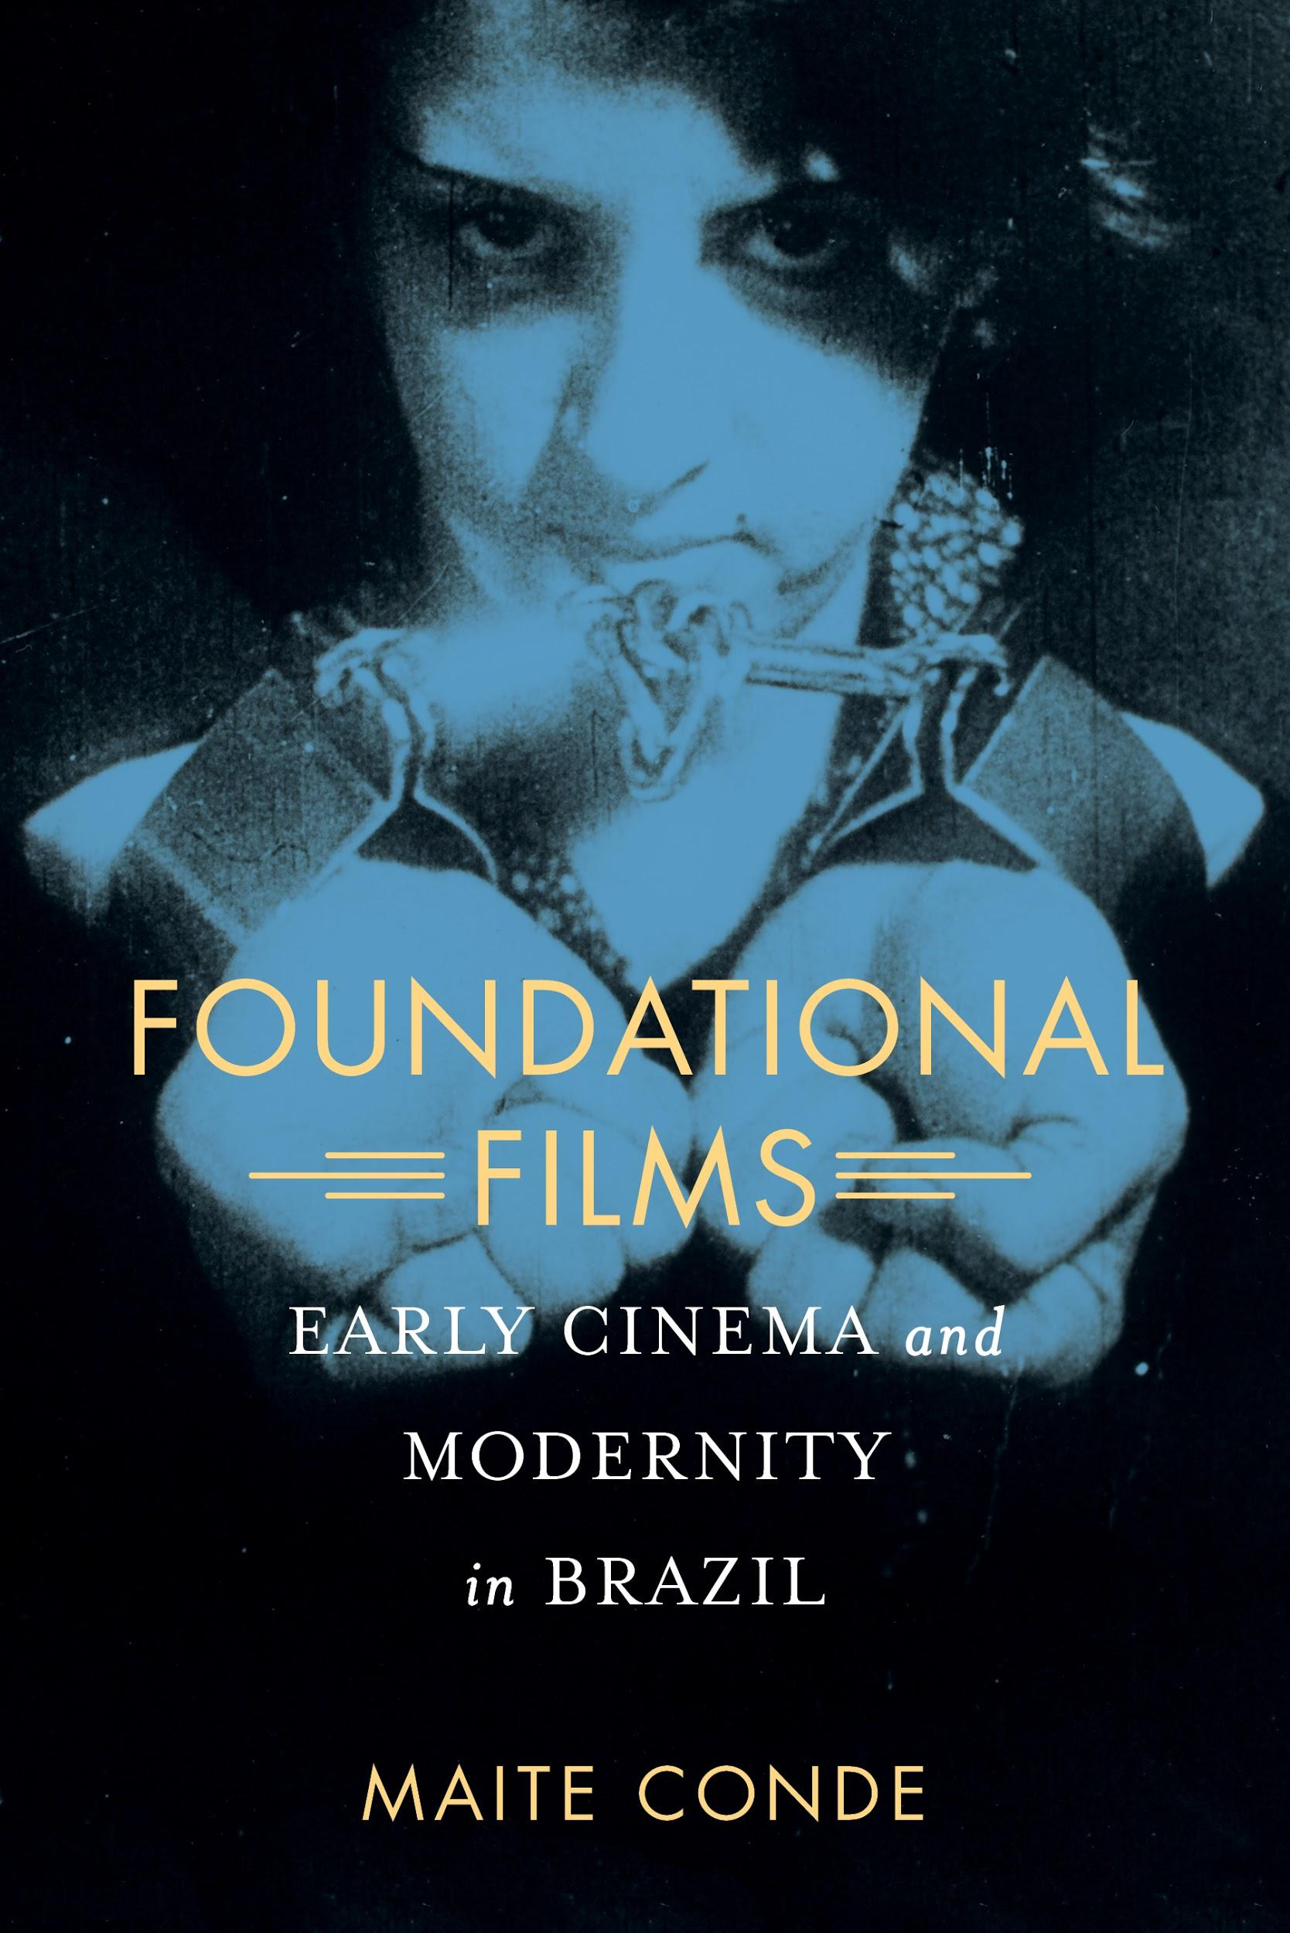
MLA Publication Prize Winners
29th Annual
Katherine Singer Kovacs Prize

Slide 24
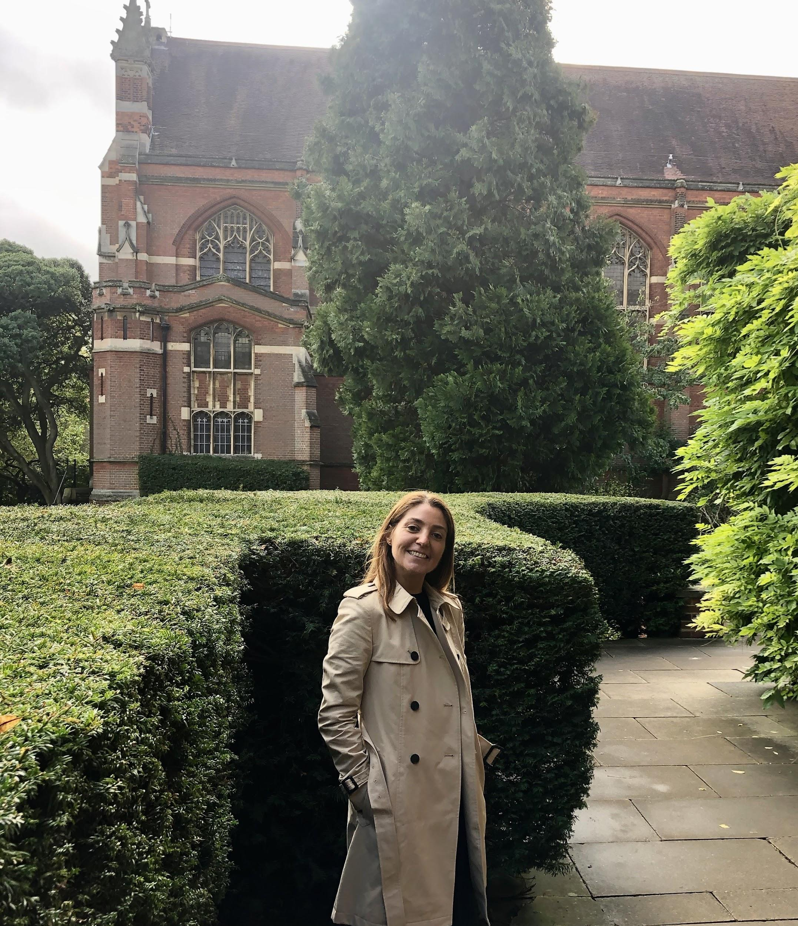
Katherine Singer Kovacs Prize
Maite Conde
Foundational Films: Early Cinema and Modernity in Brazil
I now have quite a large collection of Brazilian fanzines from the 1900s to the 1920s.

Slide 25
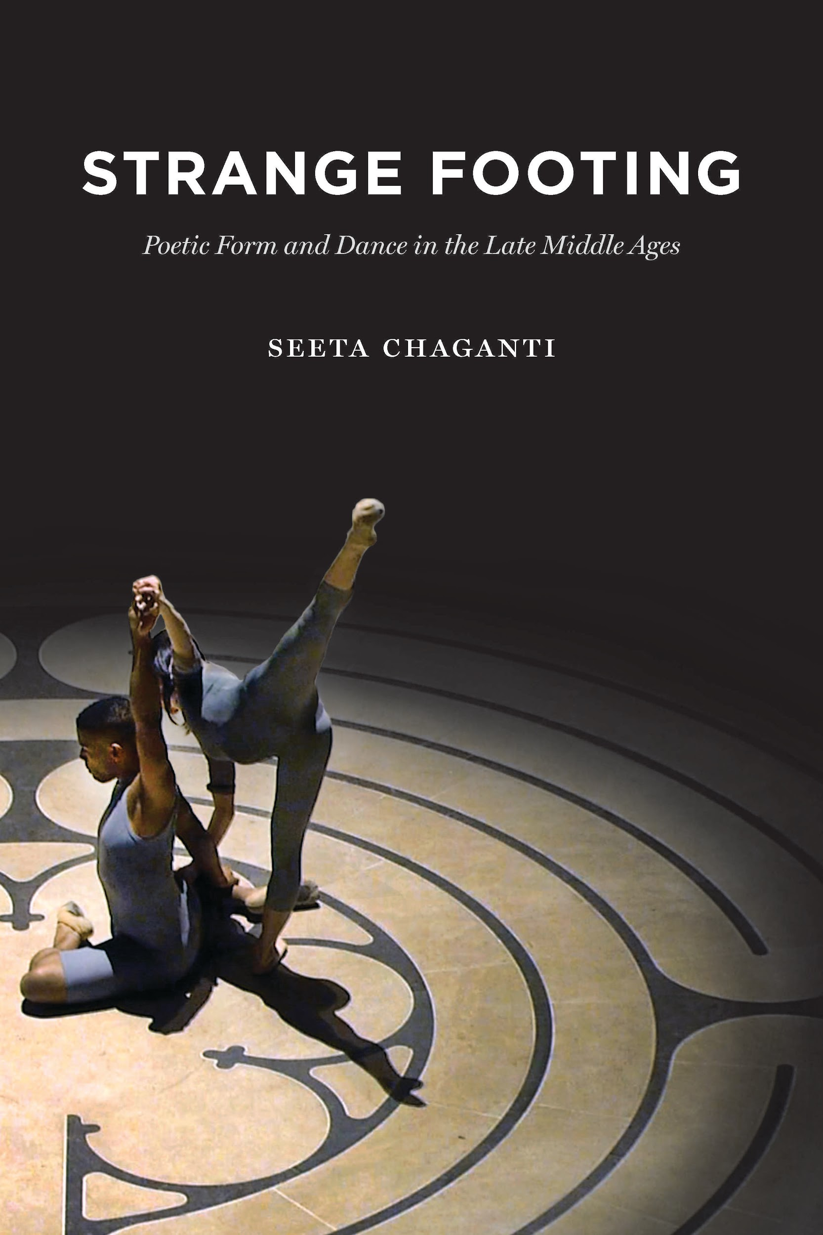
MLA Publication Prize Winners
27th Annual
Aldo and Jeanne Scaglione Prize for Comparative Literary Studies
Cover Illustration: Sharon Kung and Calvin Thomas (2017), Marika Brussel Dance Company, San Francisco Movement Arts Festival, Grace Cathedral, San Francisco, CA. Performance videography by Andy Mogg.

Slide 26

Aldo and Jeanne Scaglione Prize for Comparative Literary Studies
Seeta Chaganti
Strange Footing: Poetic Form and Dance in the Late Middle Ages
I never cease to be surprised by the medieval world’s ability to live with strangeness.
I danced for many years and took technique class the entire time I was writing this book. I could not have written it without this training.

Slide 27
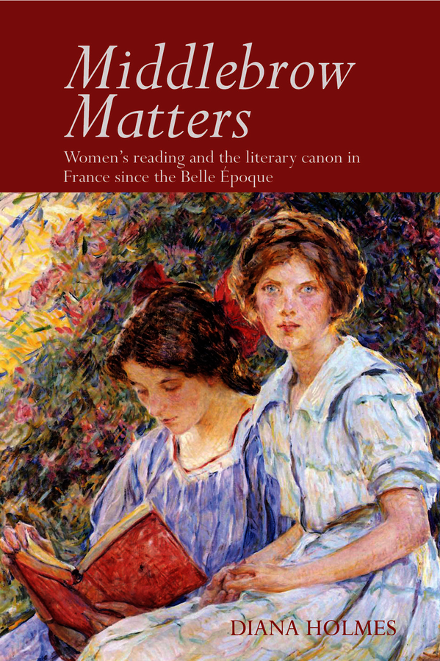
MLA Publication Prize Winners
27th Annual
Aldo and Jeanne Scaglione Prize for French and Francophone Studies

Slide 28

Aldo and Jeanne Scaglione Prize for French and Francophone Studies
Diana Holmes
Middlebrow Matters: Women’s Reading and the Literary Canon in France since the Belle Époque
I have been interested in what women readers, including myself, actually choose to read “just” for pleasure—and I felt it was time to give serious attention to the sheer delight of getting lost in a book.

Slide 29
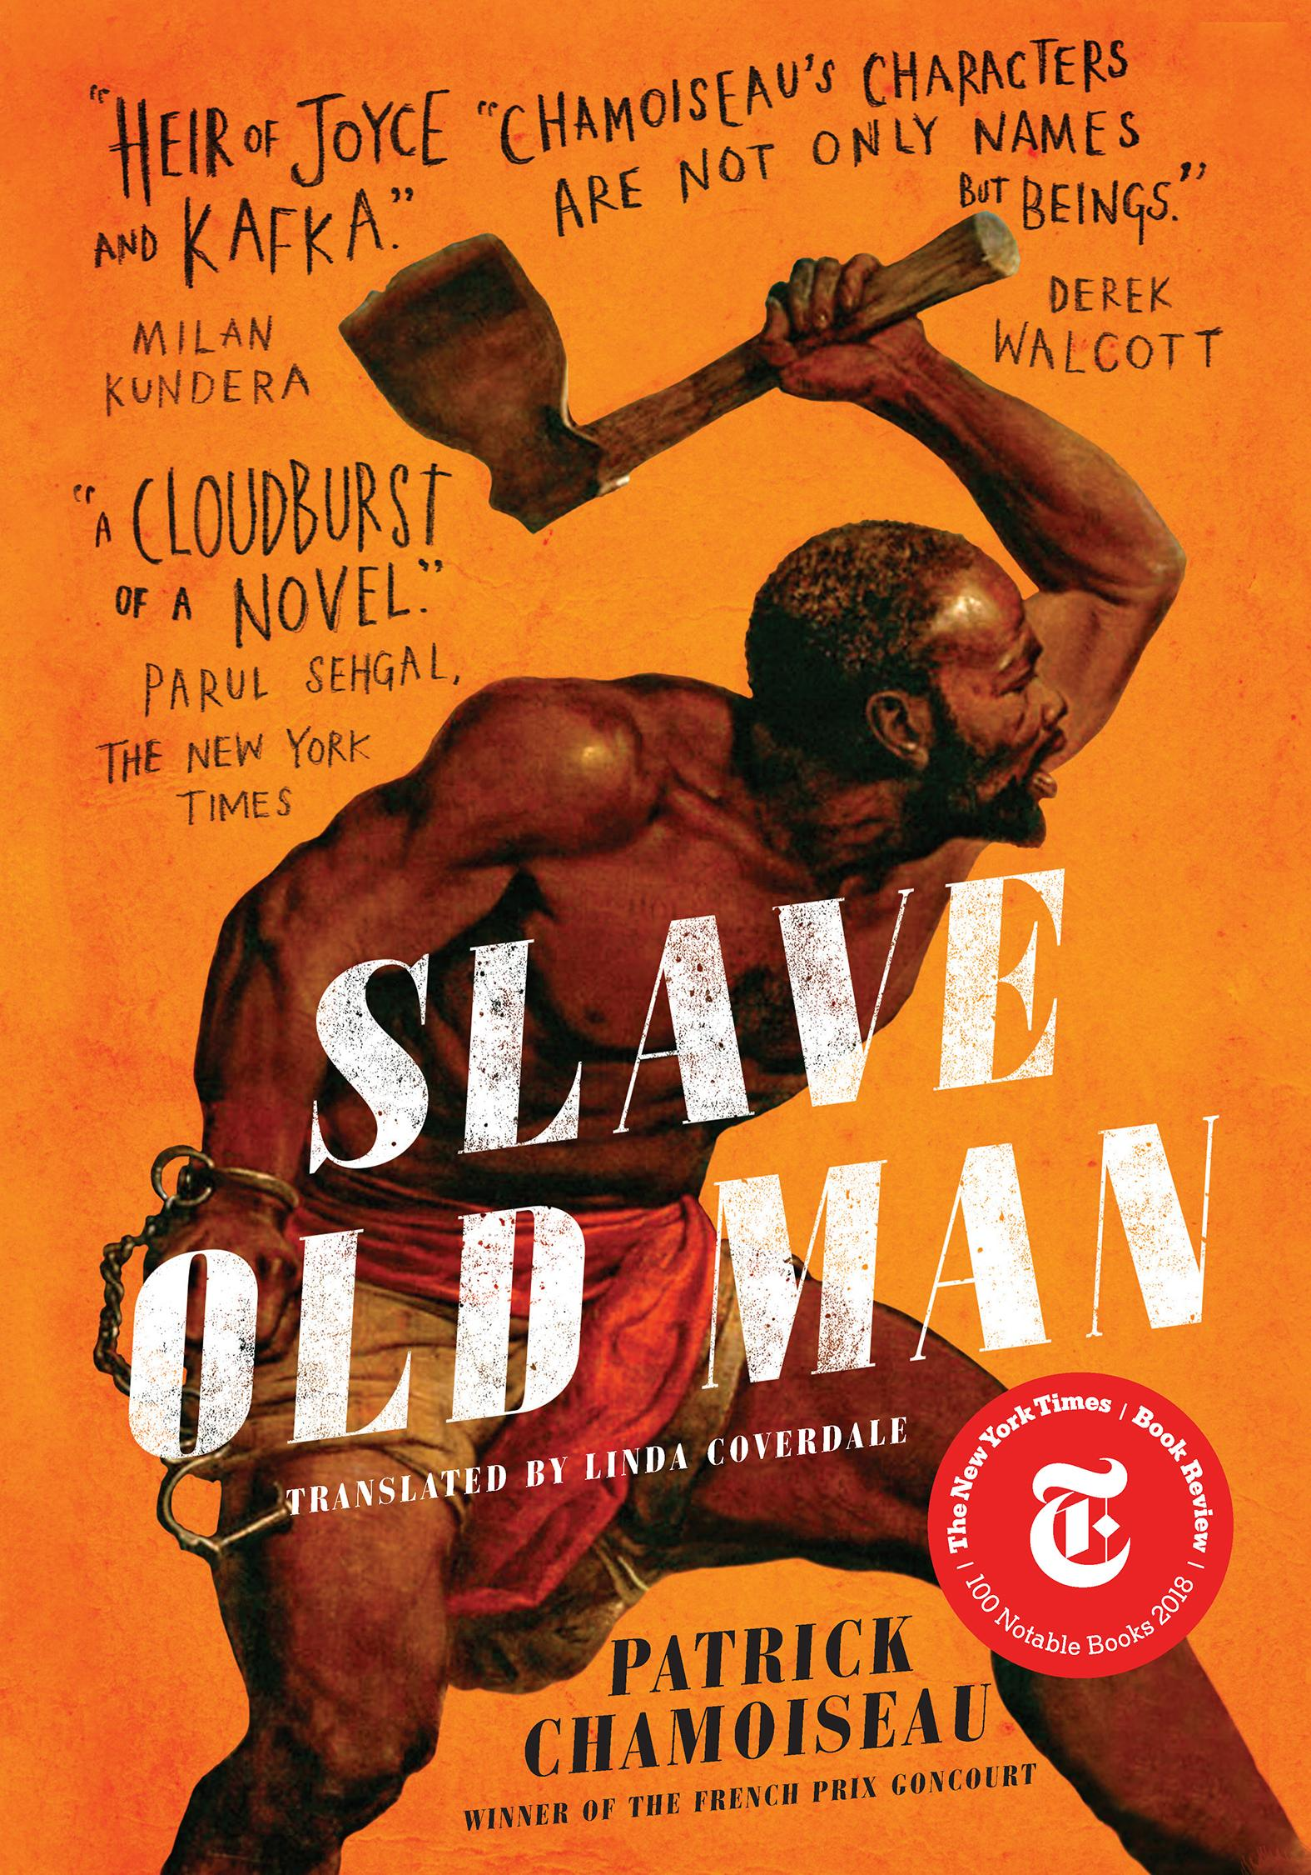
MLA Publication Prize Winners
15th Annual
Aldo and Jeanne Scaglione Prize for a Translation of a Literary Work

Slide 30
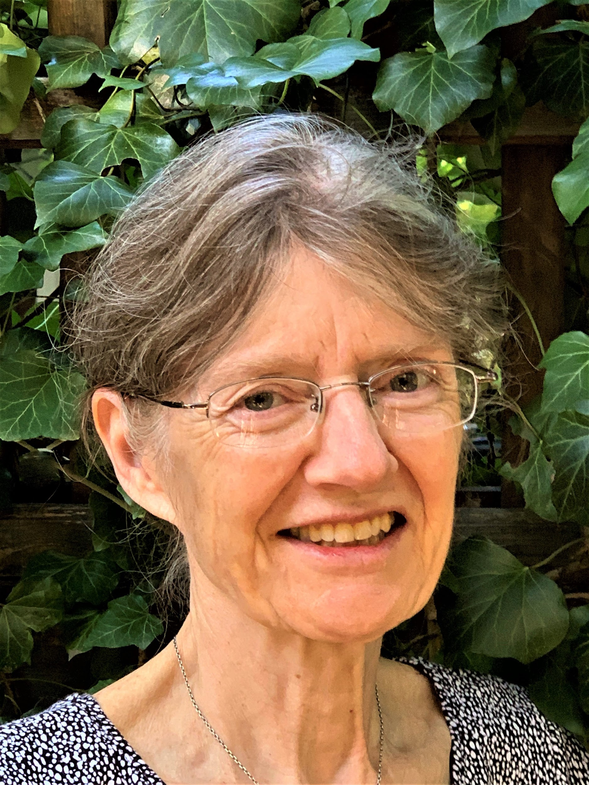
Aldo and Jeanne Scaglione Prize for a Translation of a Literary Work
Linda Coverdale
Slave Old Man, by Patrick Chamoiseau
Although Chamoiseau’s first novel stole my heart in 1986, it was beyond my translating skills. I apprenticed myself with some of his other works, and when Slave Old Man resurfaced like a sleeping beauty in 2017, I pounced.

Slide 31
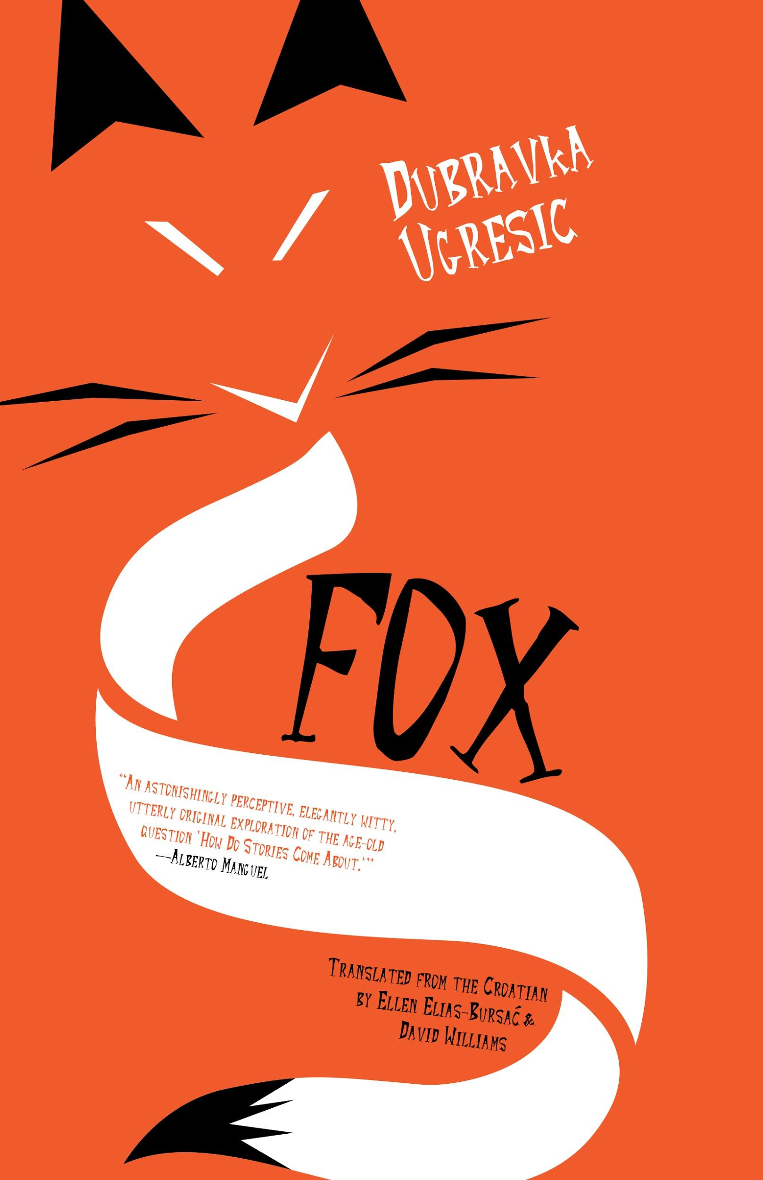
MLA Publication Prize Winners
15th Annual
Aldo and Jeanne Scaglione Prize for a Translation of a Literary Work
Honorable Mention

Slide 32
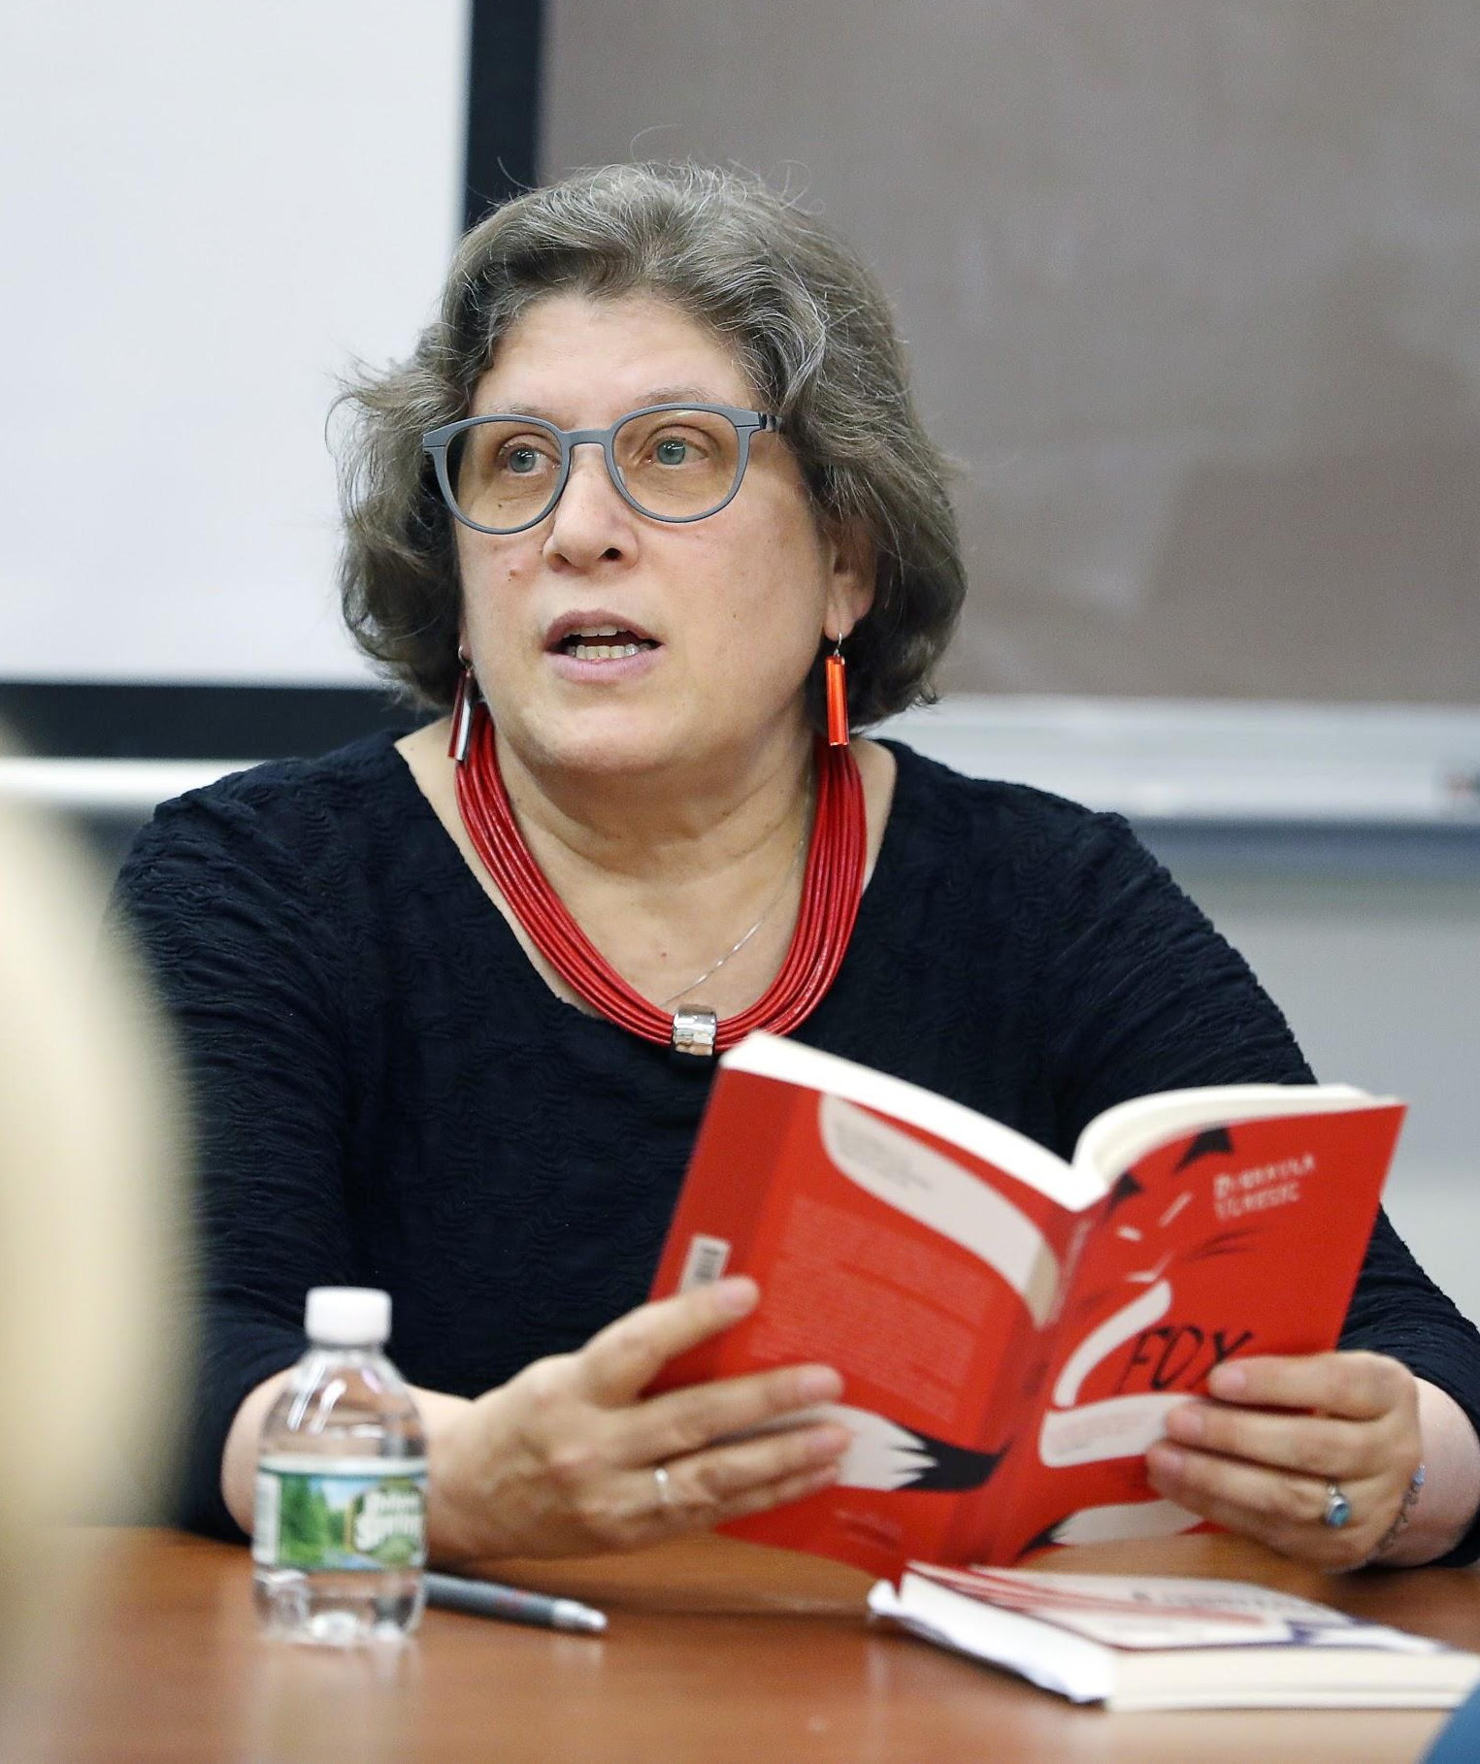

Aldo and Jeanne Scaglione Prize for a Translation of a Literary Work
Honorable Mention
Ellen Elias-Bursać and David Williams
Fox, by Dubravka Ugresic
The line between fiction and nonfiction is pretty porous with Dubravka. –Williams
Translating her language is now a part of my thought process. –Elias-Bursać

Slide 33
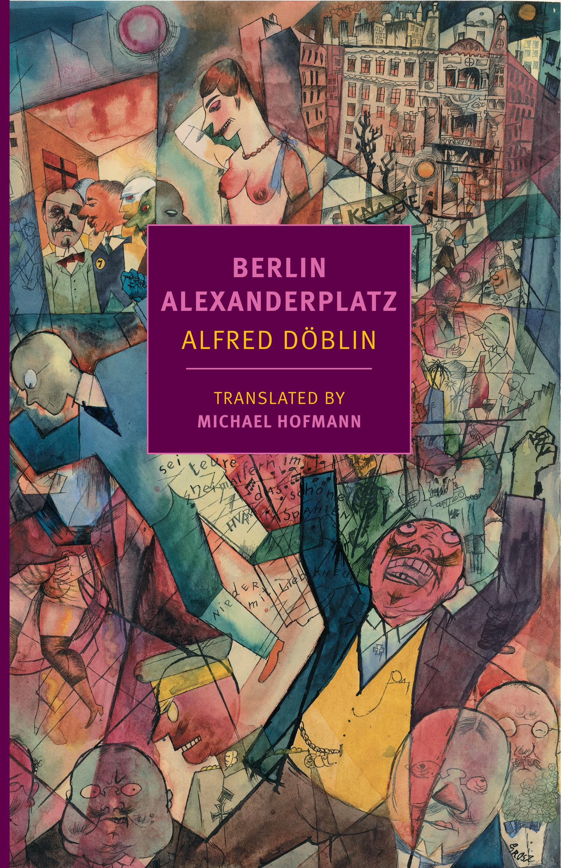
MLA Publication Prize Winners
15th Annual
Aldo and Jeanne Scaglione Prize for a Translation of a Literary Work
Honorable Mention

Slide 34
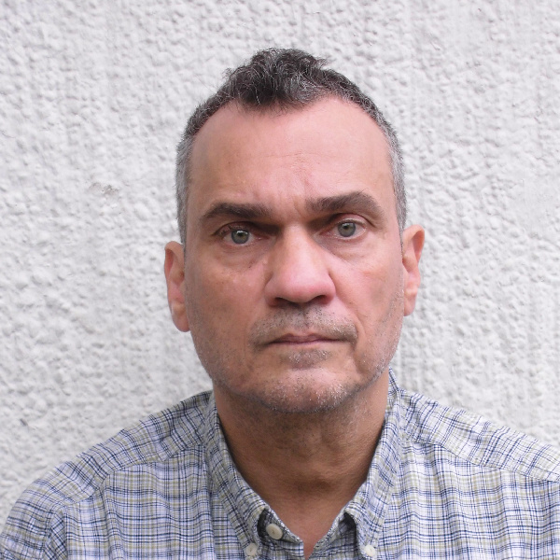
Aldo and Jeanne Scaglione Prize for a Translation of a Literary Work
Honorable Mention
Michael Hofmann
Berlin Alexanderplatz, by Alfred Döblin
“Glacial air. February. People in coats. Whoever owns a mink, wears it, whoever doesn’t, doesn’t. The women wear thin stockings and are freezing, but it looks nice.”

Slide 35
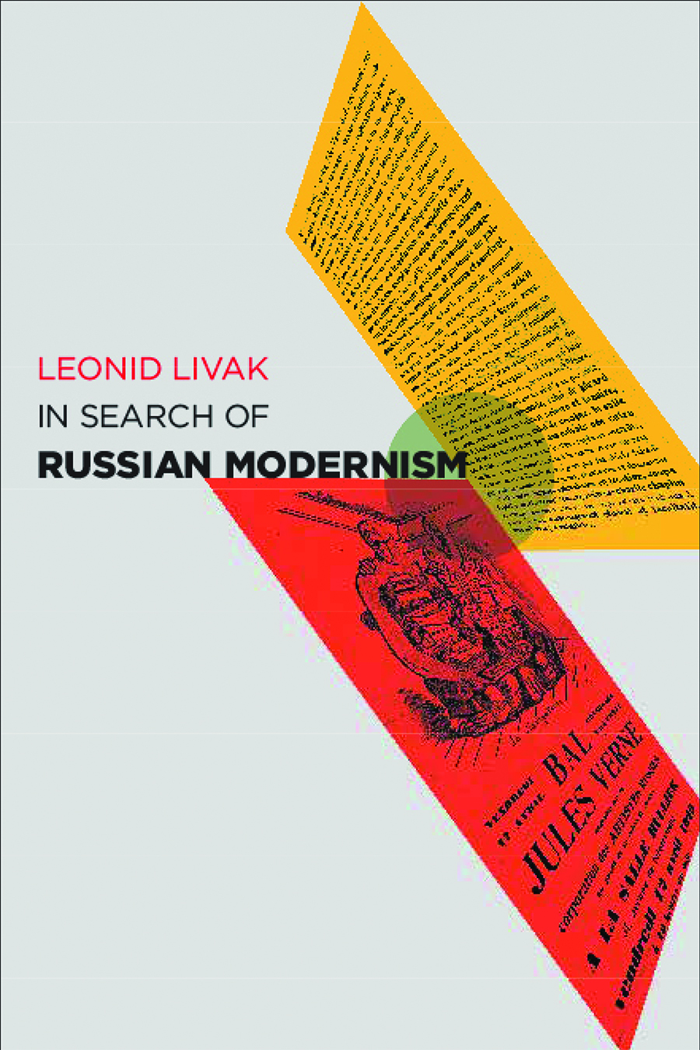
MLA Publication Prize Winners
13th Biennial
Aldo and Jeanne Scaglione Prize for Studies in
Slavic Languages and Literatures

Slide 36
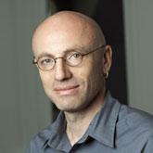
Aldo and Jeanne Scaglione Prize for Studies in Slavic Languages
and Literatures
Leonid Livak
In Search of Russian Modernism
“I have reopened to critical questioning the field’s methodological assumptions, doubting the soundness of the analytical tools at our disposal and suggesting alternatives to conventional ways of thinking Russian modernism.”

Slide 37

MLA Publication Prize Winners
13th Biennial
Aldo and Jeanne Scaglione Prize for Studies in Slavic Languages and Literatures
Honorable Mention

Slide 38
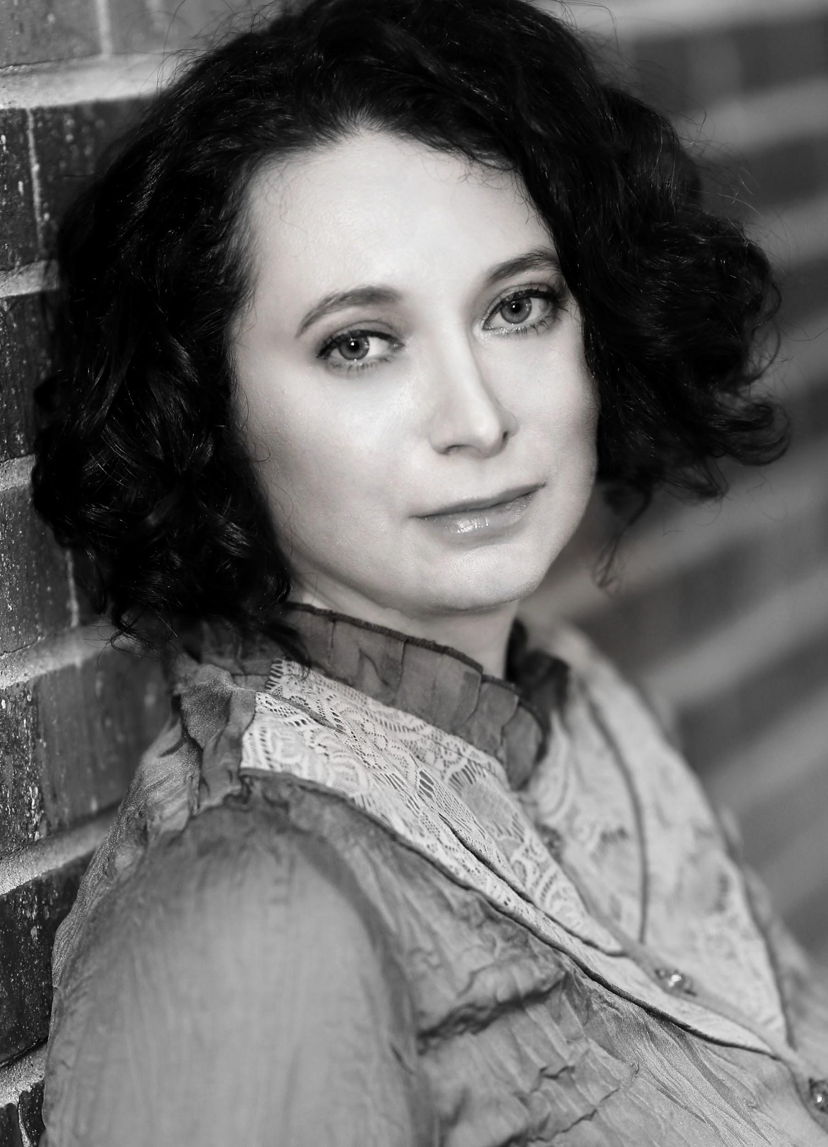
Aldo and Jeanne Scaglione Prize for Studies in Slavic Languages
and Literatures Honorable Mention
Eleonory Gilburd
To See Paris and Die: The Soviet Lives of Western Culture
There were so many non-Soviet books, images, and things in my late-Soviet childhood. I wanted to understand how this could have happened.

Slide 39
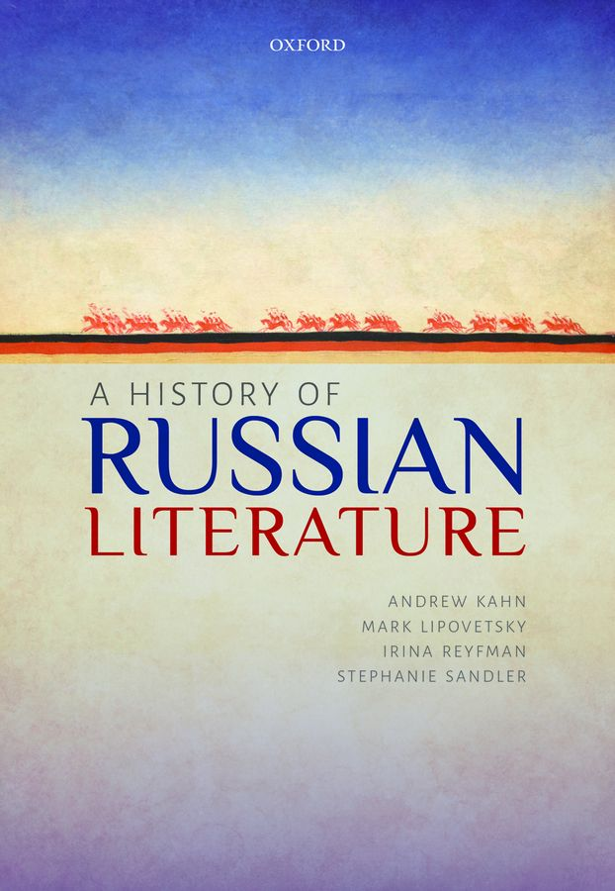
MLA Publication Prize Winners
13th Biennial
Aldo and Jeanne Scaglione Prize for Studies in Slavic Languages and Literatures
Honorable Mention

Slide 40
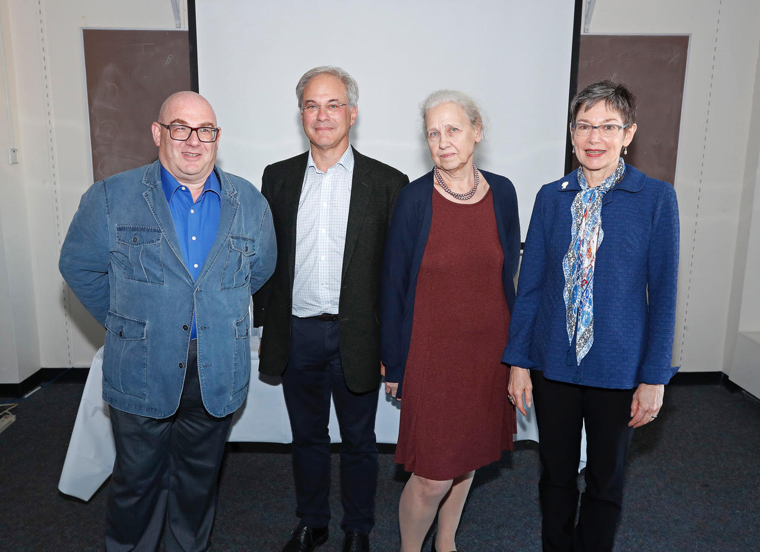
Aldo and Jeanne Scaglione Prize for Studies in Slavic Languages
and Literatures Honorable Mention
Andrew Kahn, Mark Lipovetsky, Irina Reyfman, and Stephanie Sandler
A History of Russian Literature
We were drawn by the chance to work together and think about the literary tradition from a much broader perspective than any of us does in our own scholarship.

Slide 41
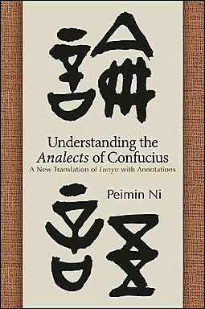
MLA Publication Prize Winners
13th Biennial
Aldo and Jeanne Scaglione Prize for a Translation of a Scholarly Study of Literature

Slide 42

Aldo and Jeanne Scaglione Prize for a Translation of a Scholarly Study
of Literature
Peimin Ni
Understanding the Analects of Confucius: A New Translation of Lunyu with Annotations
“Given the advantage of studying previous translations, I have learned from their merits and tried to avoid their shortcomings.”

Slide 43
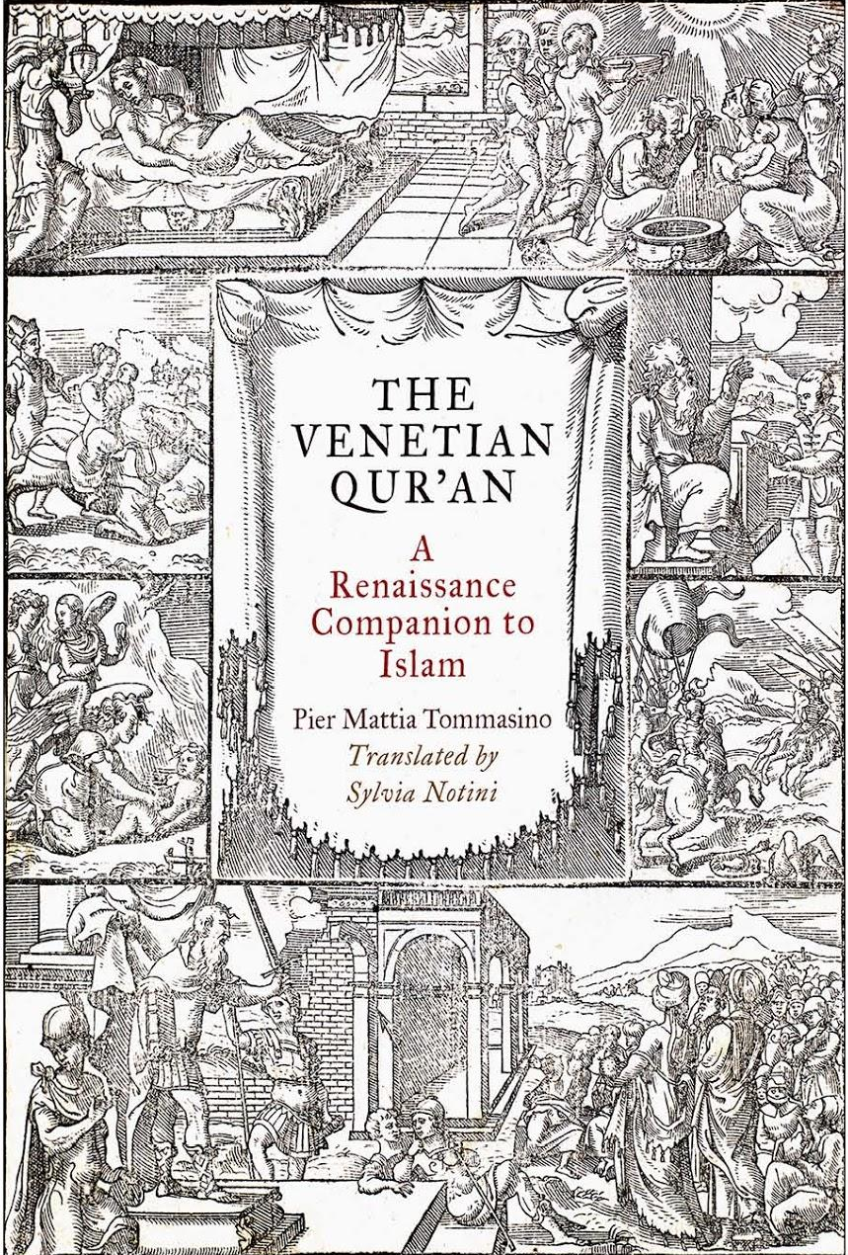
MLA Publication Prize Winners
13th Biennial
Aldo and Jeanne Scaglione Prize for a Translation of a Scholarly Study of Literature

Slide 44
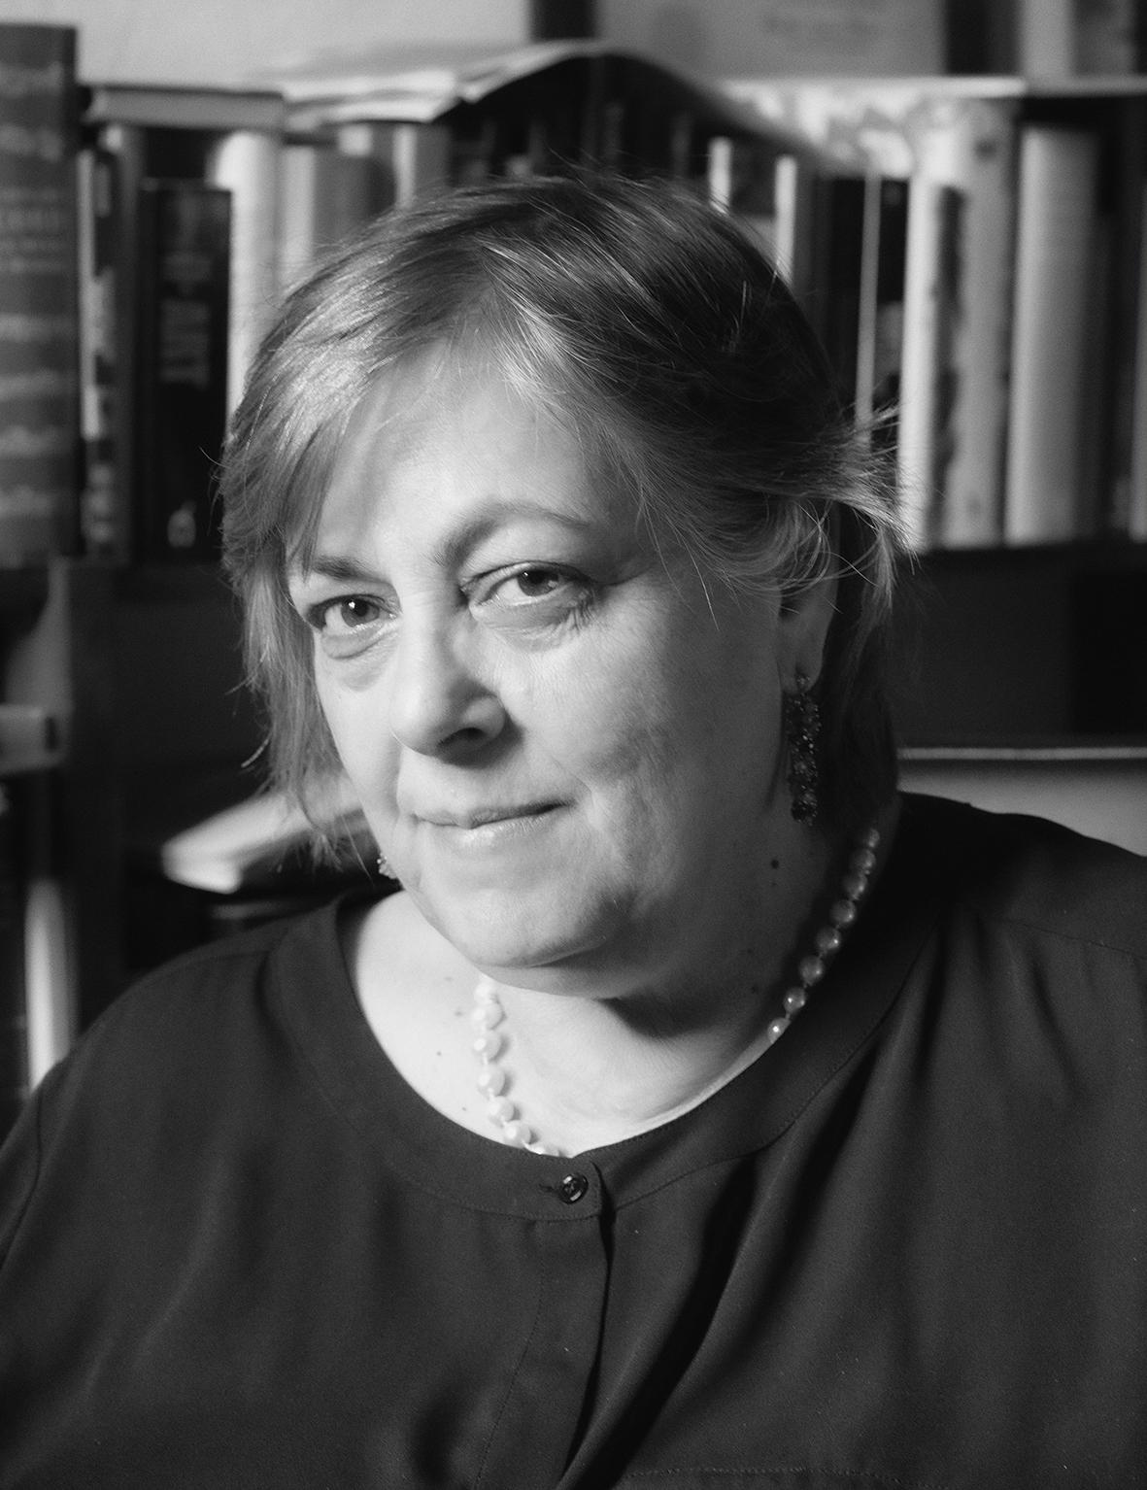
Aldo and Jeanne Scaglione Prize for a Translation of a Scholarly Study
of Literature
Sylvia Adrian Notini
The Venetian Qur’an: A Renaissance Companion to Islam, by Pier Mattia Tommasino
Tommasino’s book is not just about the first Italian translation of the Qur’an, it is about the very process of translating as well.

Slide 45
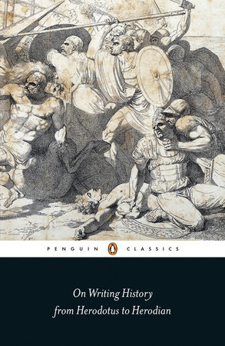
MLA Publication Prize Winners
13th Biennial
Aldo and Jeanne Scaglione Prize for a Translation of a Scholarly Study of Literature
Honorable Mention

Slide 46

Aldo and Jeanne Scaglione Prize for a Translation of a Scholarly Study
of Literature Honorable Mention
John Marincola
On Writing History: From Herodotus to Herodian
I was curious about how Greek and Roman readers and critics thought about the past and about what should be preserved from the past and in what manner.

Slide 47
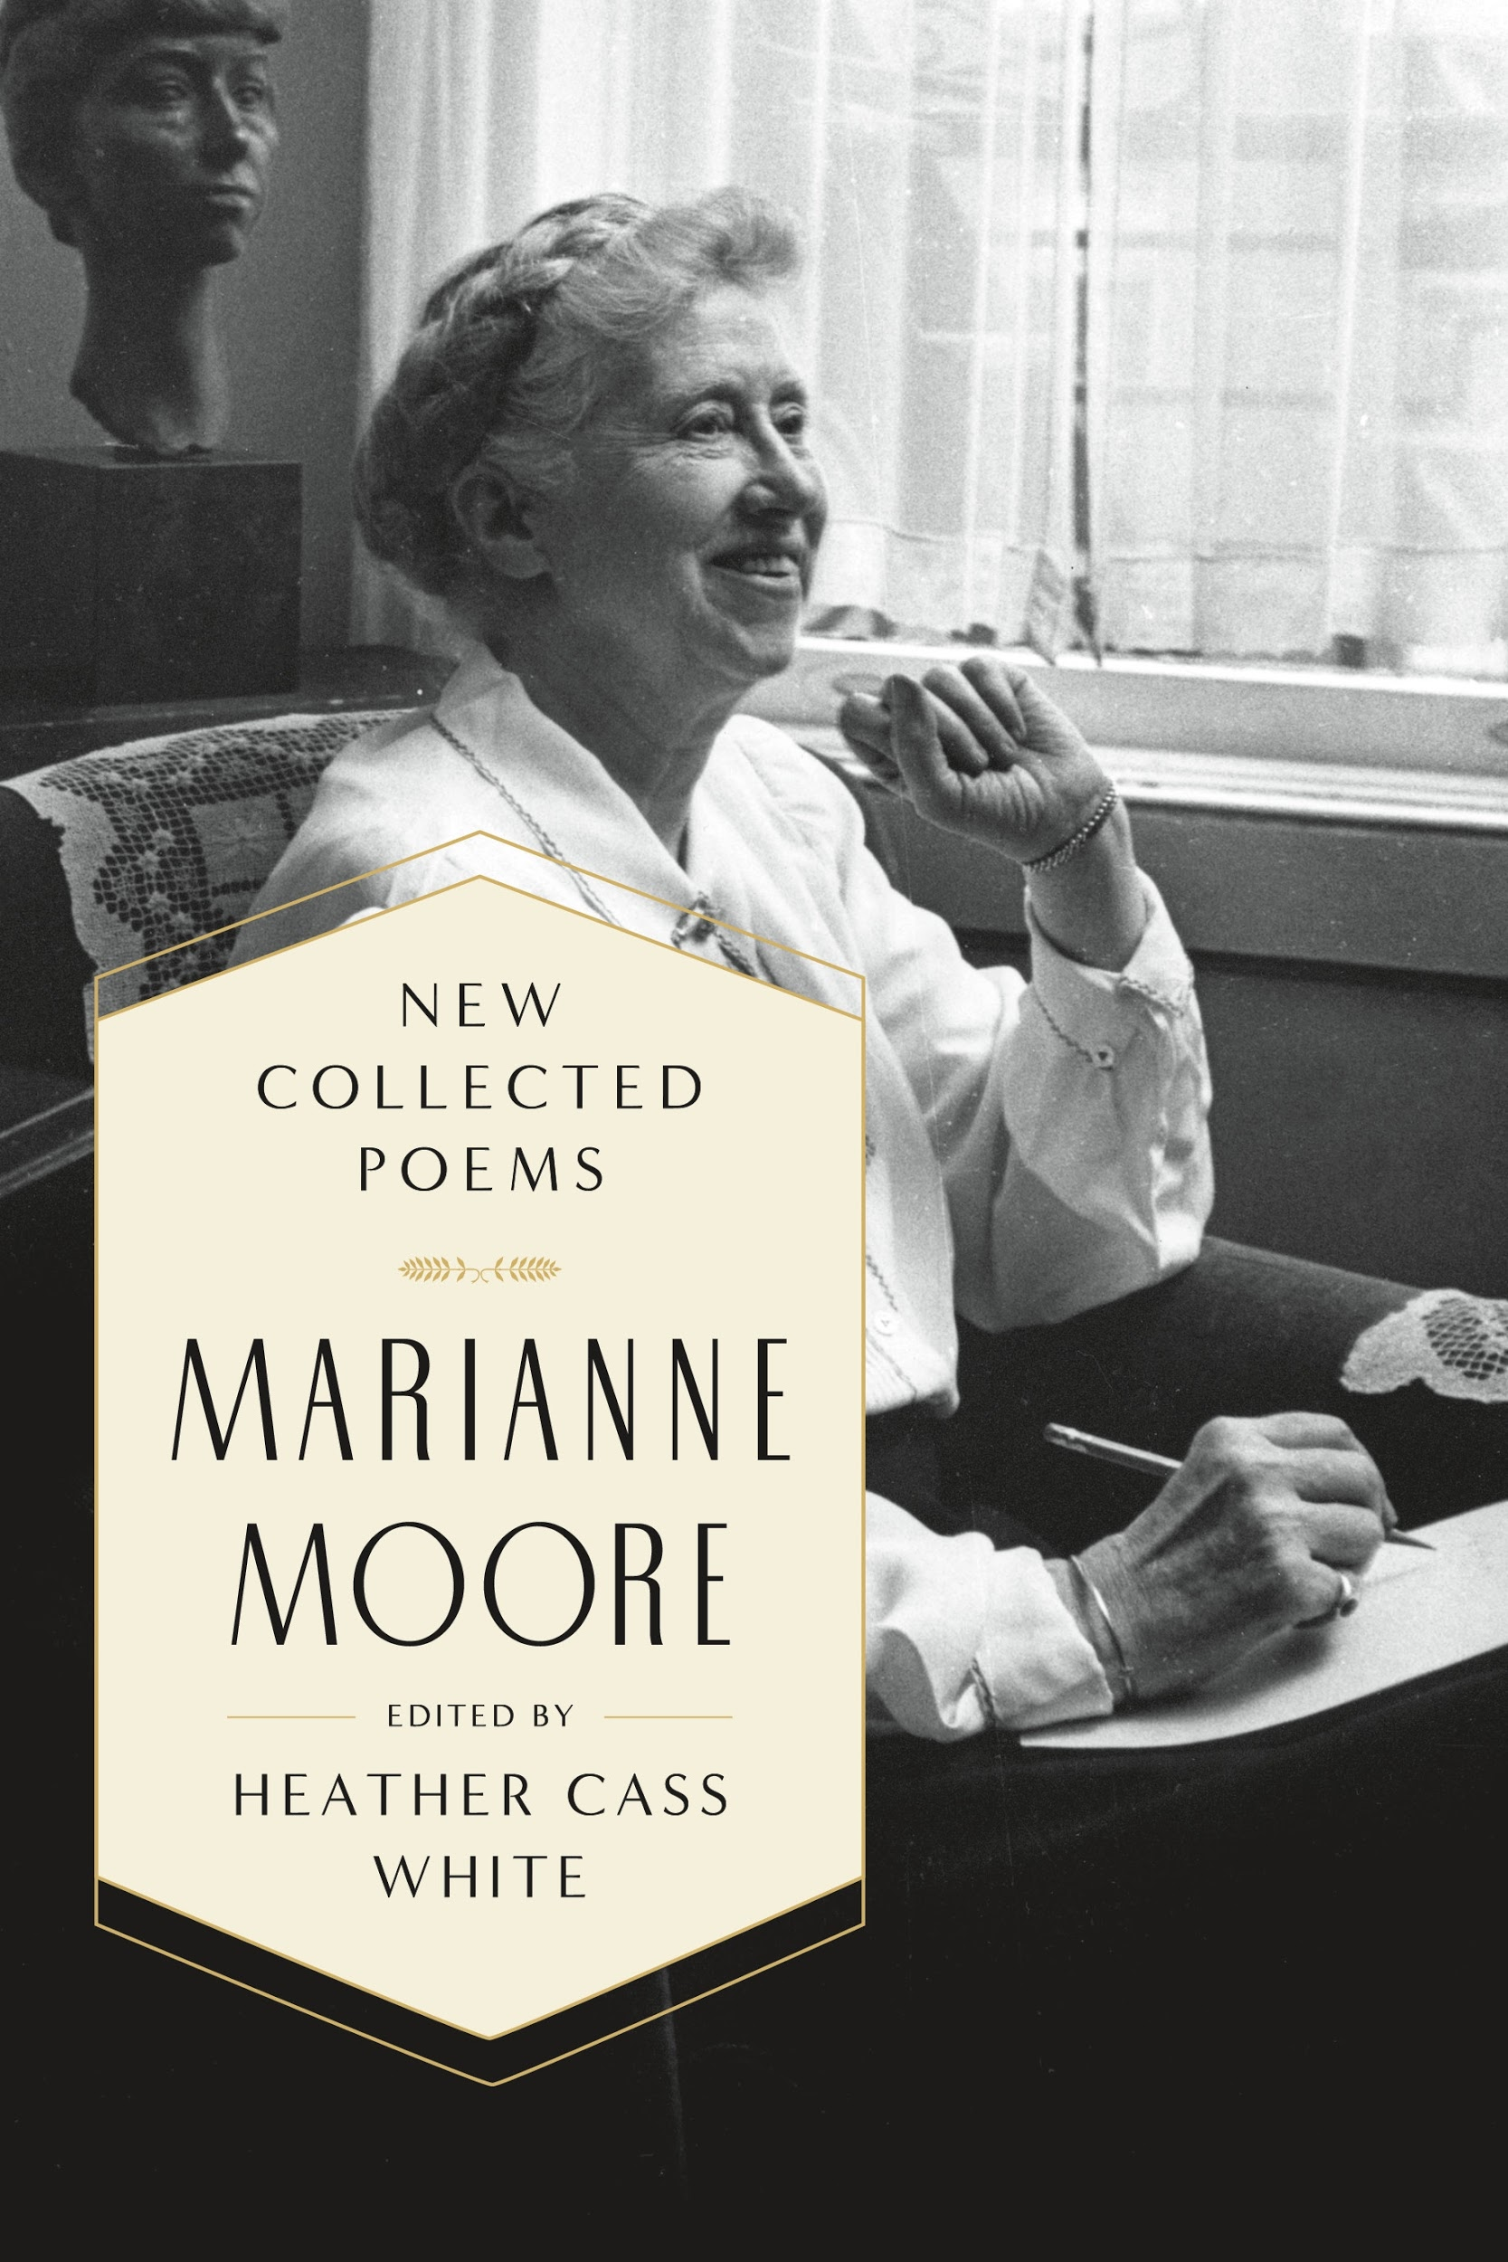
MLA Publication Prize Winners
13th Biennial
MLA Prize for a Scholarly Edition

Slide 48
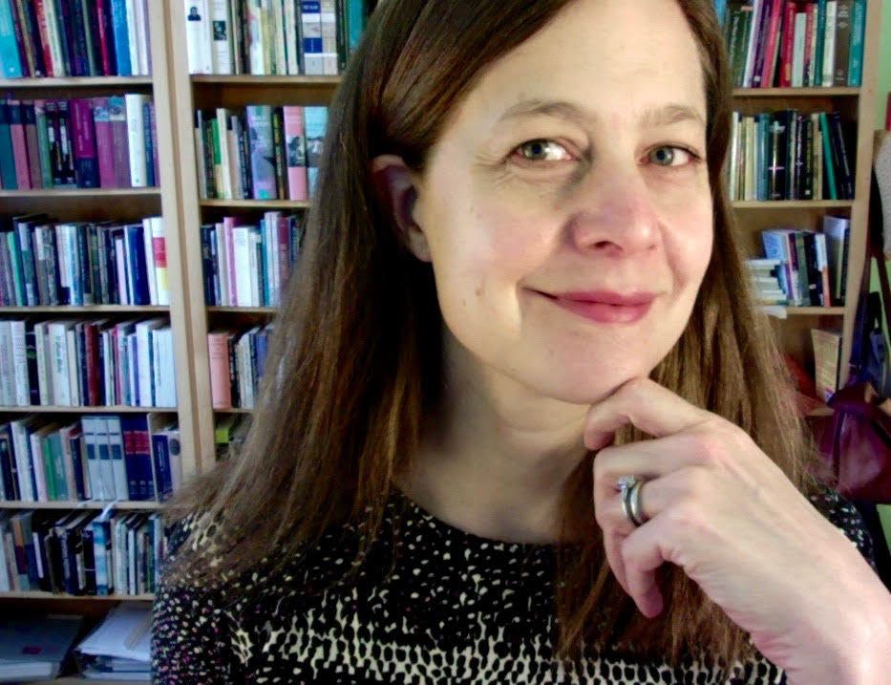
MLA Prize for a Scholarly Edition
Heather Cass White
New Collected Poems: Marianne Moore
Years ago, when I first read Moore’s long-out-of-print poems, I simply couldn’t believe she’d dropped them, and I was a little panicked at the thought that they might be lost for good.

Slide 49
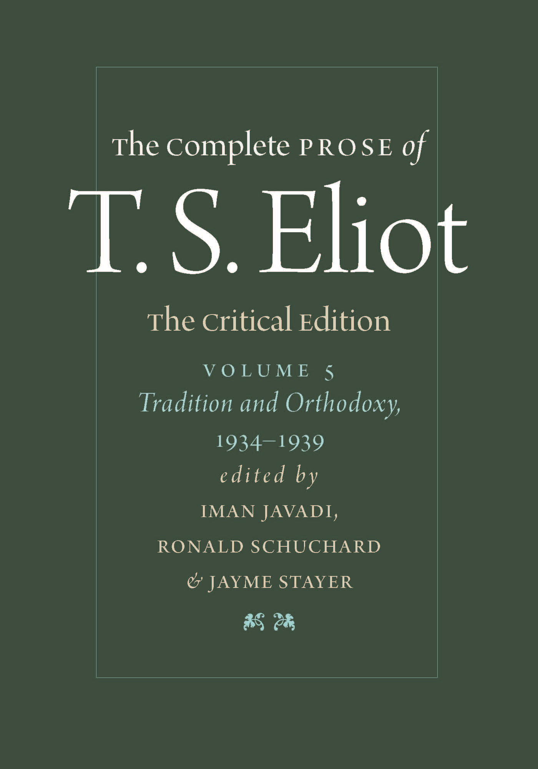
MLA Publication Prize Winners
13th Biennial
MLA Prize for a Scholarly Edition

Slide 50
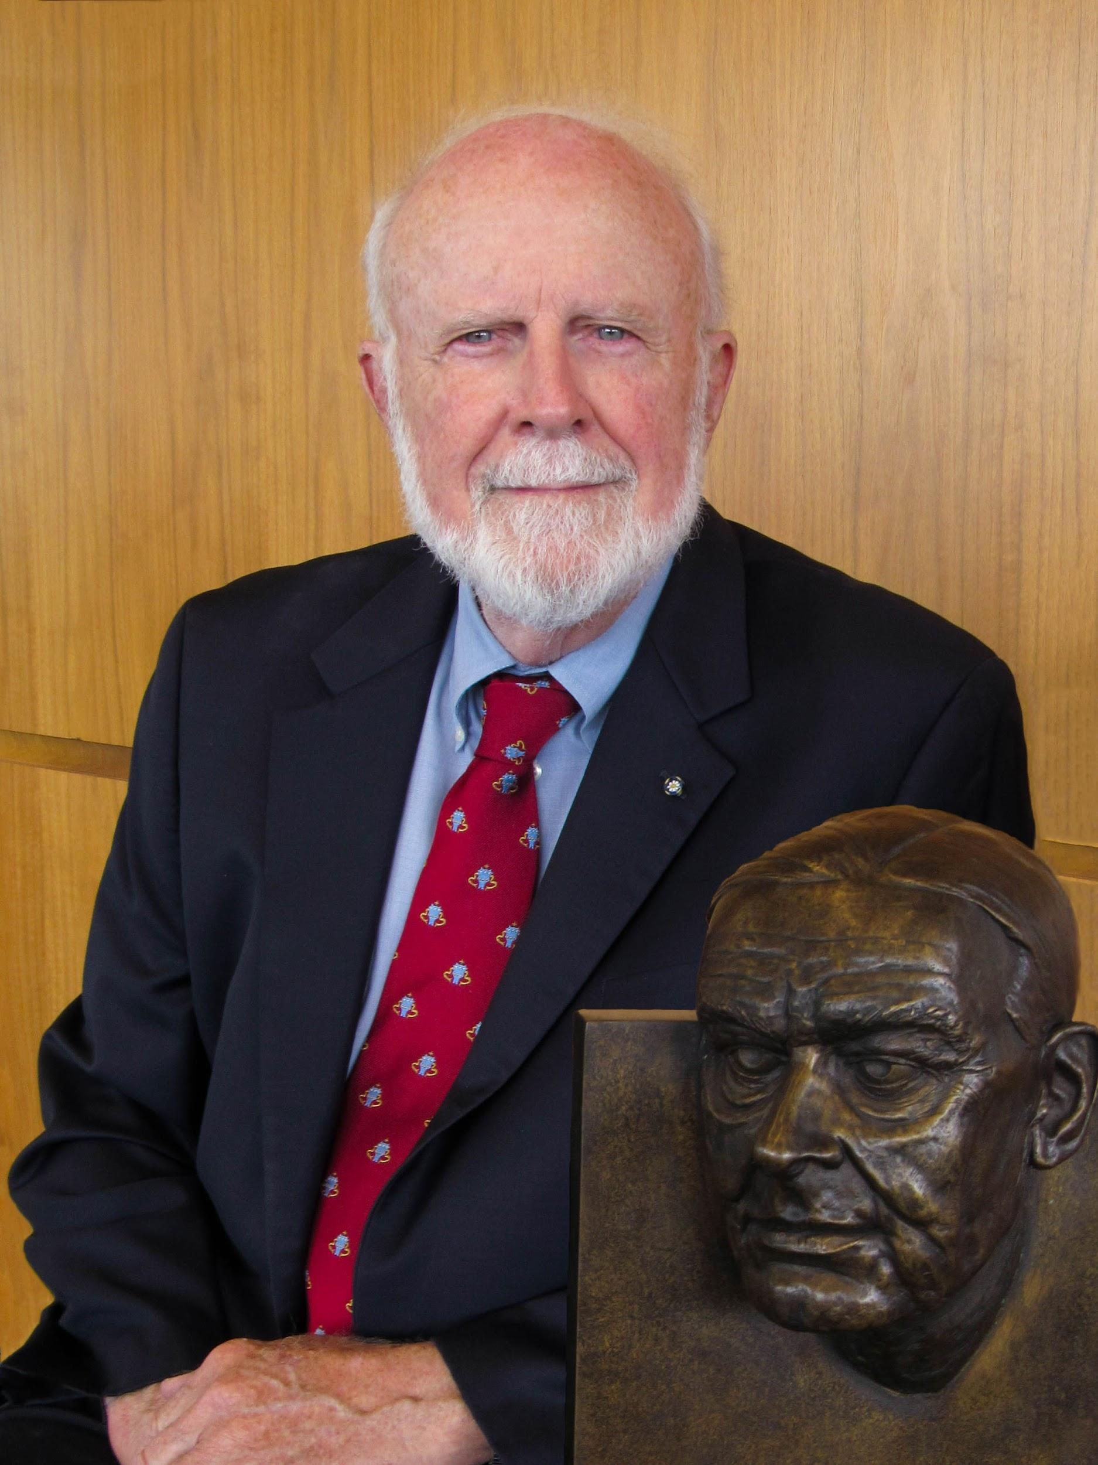

MLA Prize for a Scholarly Edition
Ronald Schuchard, Iman Javadi, and Jayme Stayer
Tradition and Orthodoxy, 1934–1939, volume 5 of The Complete Prose of T. S. Eliot:
The Critical Edition
Though the major social and political crises of the decade receive Eliot’s sustained attention, no cultural dustup is too inconspicuous for his commentary, and even humble causes capture his attention.

Slide 51
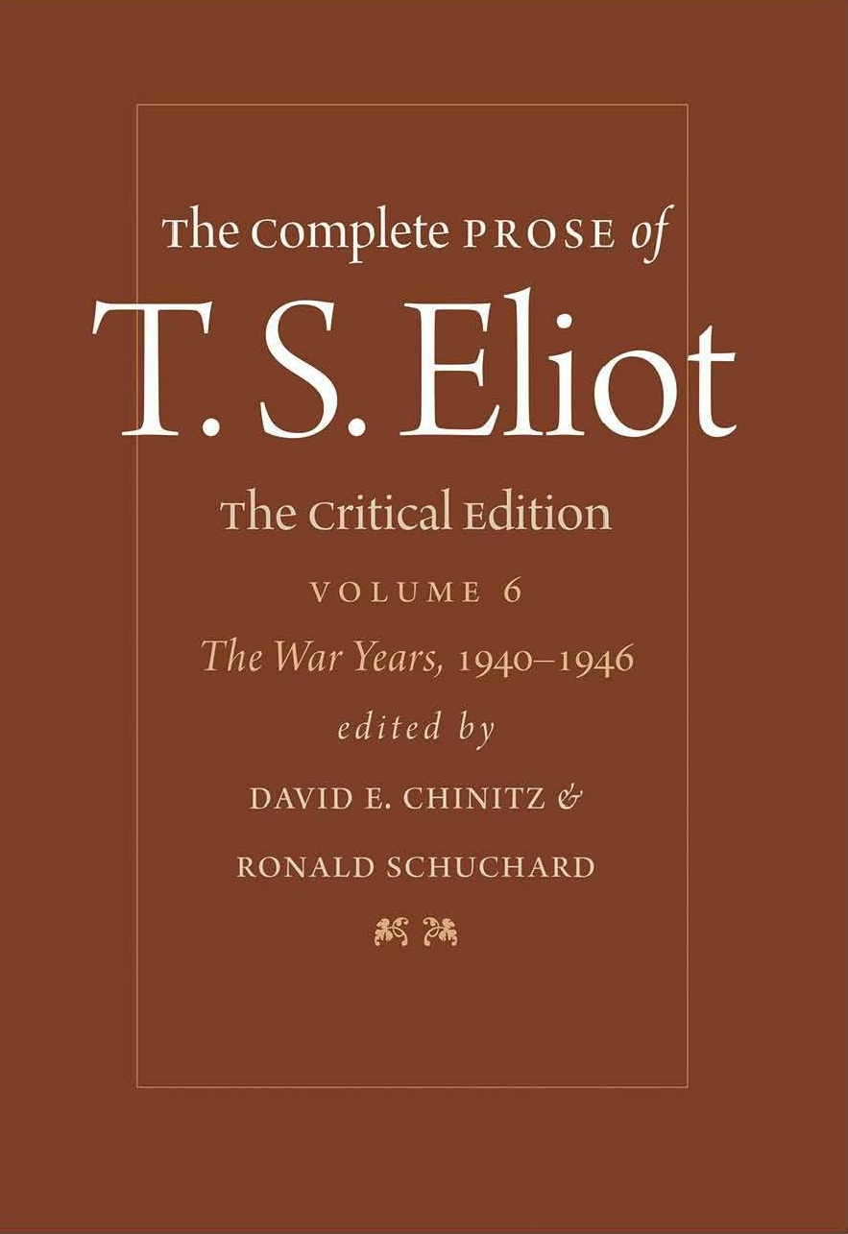
MLA Publication Prize Winners
13th Biennial
MLA Prize for a Scholarly Edition

Slide 52
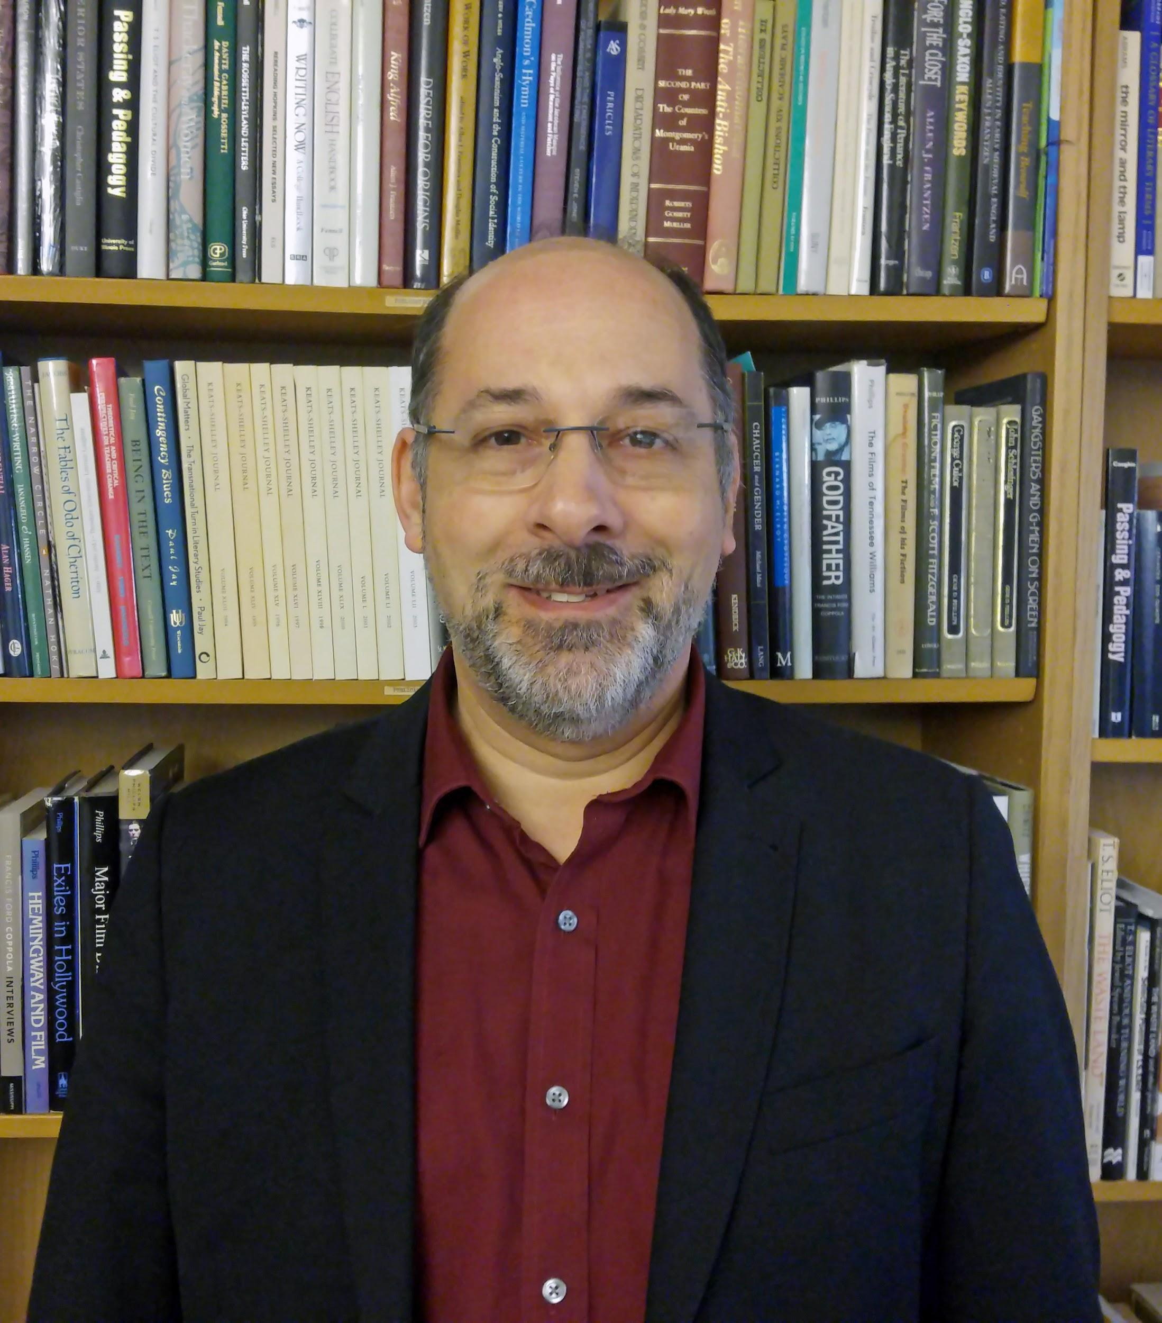
MLA Prize for a Scholarly Edition
Ronald Schuchard and David E. Chinitz
The War Years, 1940–1946, volume 6 of The Complete Prose of T. S. Eliot: The Critical Edition
“ . . . the war remains the grim background for Eliot’s prose of this period whether he is writing on the ballet, the book trade, Kipling, Poland, or Poe.”

Slide 53
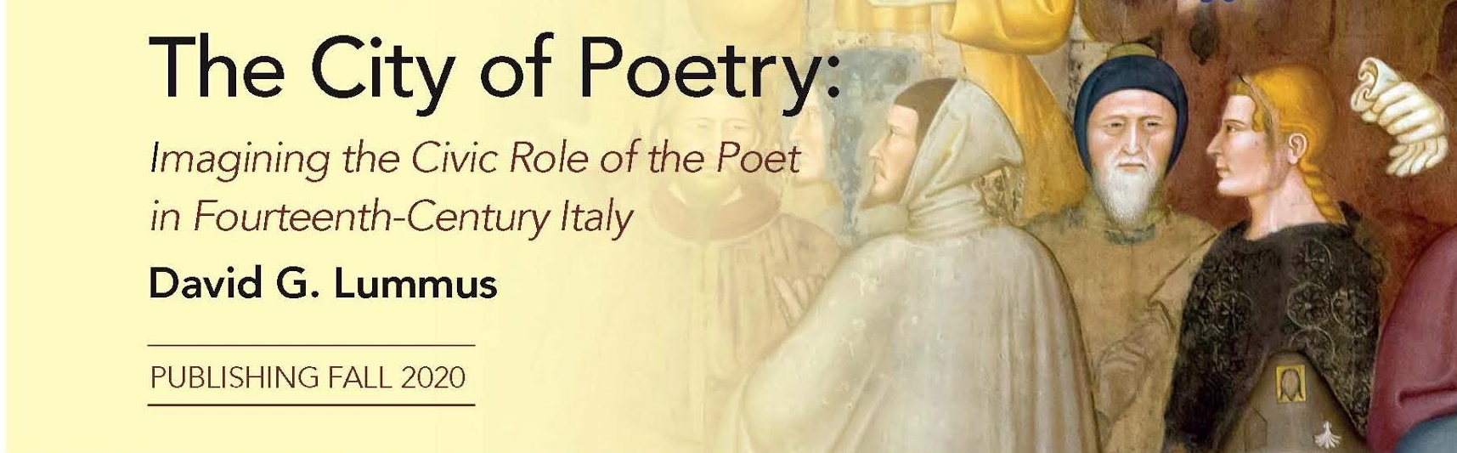
MLA Publication Prize Winners
22nd Annual
Aldo and Jeanne Scaglione Publication Award for a Manuscript in Italian Literary Studies

Slide 54

Aldo and Jeanne Scaglione Publication Award for a Manuscript in Italian Literary Studies
David G. Lummus
The City of Poetry: Imagining the Civic Role of the Poet in Fourteenth-Century Italy
I wanted to understand why poets defended poetry with such vigor at the beginning of the Italian literary tradition. What did it mean to be a poet? What counted as poetry?

Slide 55
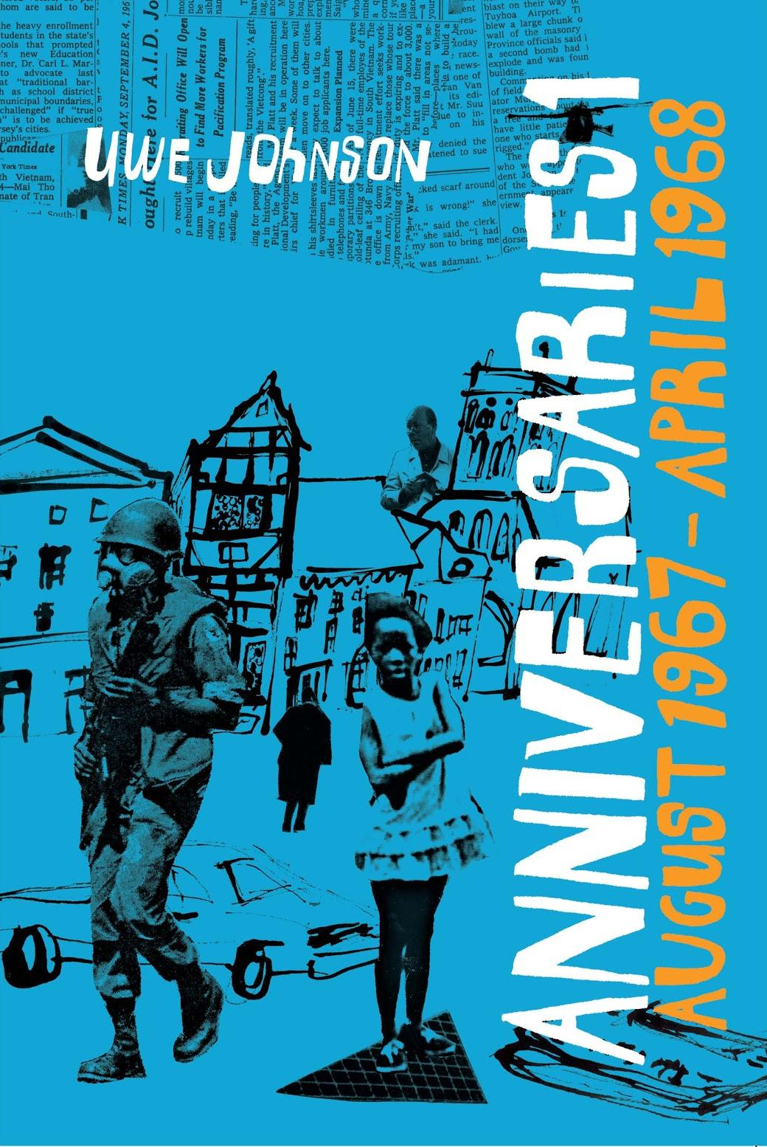
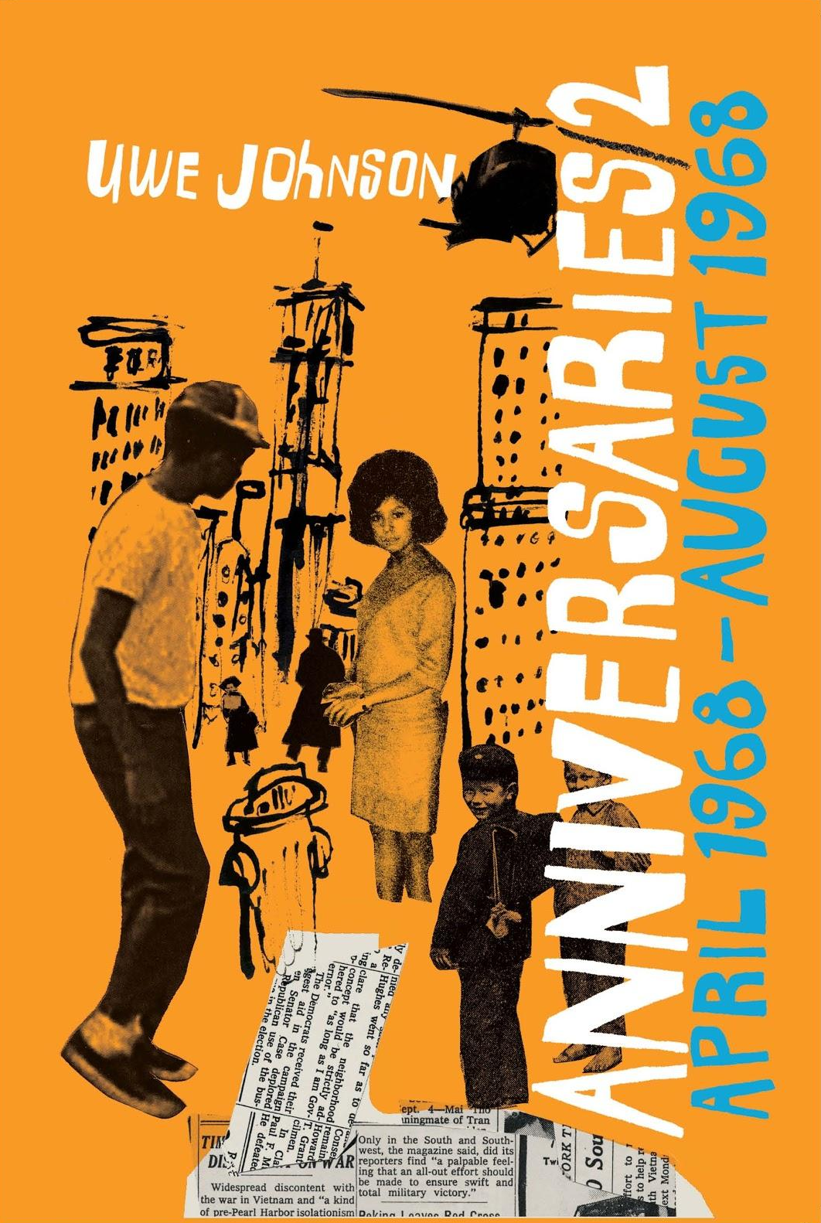
MLA Publication Prize Winners
12th Annual
Lois Roth Award

Slide 56

Lois Roth Award
Damion Searls
Anniversaries: From a Year in the Life of Gesine Cresspahl, by Uwe Johnson
This is one of the canonical great novels, and it takes place in New York City, three blocks away from where I grew up—it’s a novel-of-a-lifetime for most readers and certainly the translation project of a lifetime for me.

Slide 57
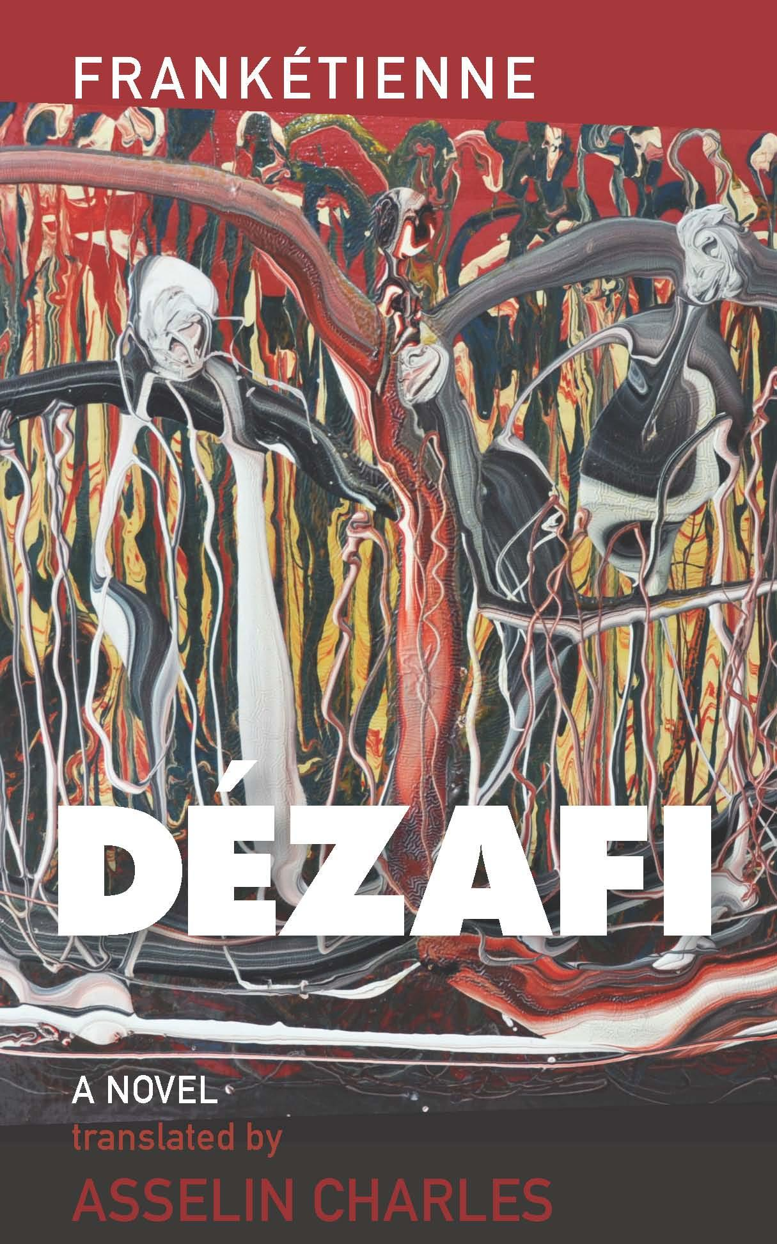
MLA Publication Prize Winners
12th Annual
Lois Roth Award
Honorable Mention

Slide 58

Lois Roth Award Honorable Mention
Asselin Charles
Dézafi, by Frankétienne
“All the way to Guinea the native speech flowers and fruits on our tongues, moves us to our very entrails. Our umbilical cords have budded; countless native flowers bloom all over our bodies.”

Slide 59

MLA Publication Prize Winners
12th Annual
Lois Roth Award
Honorable Mention

Slide 60
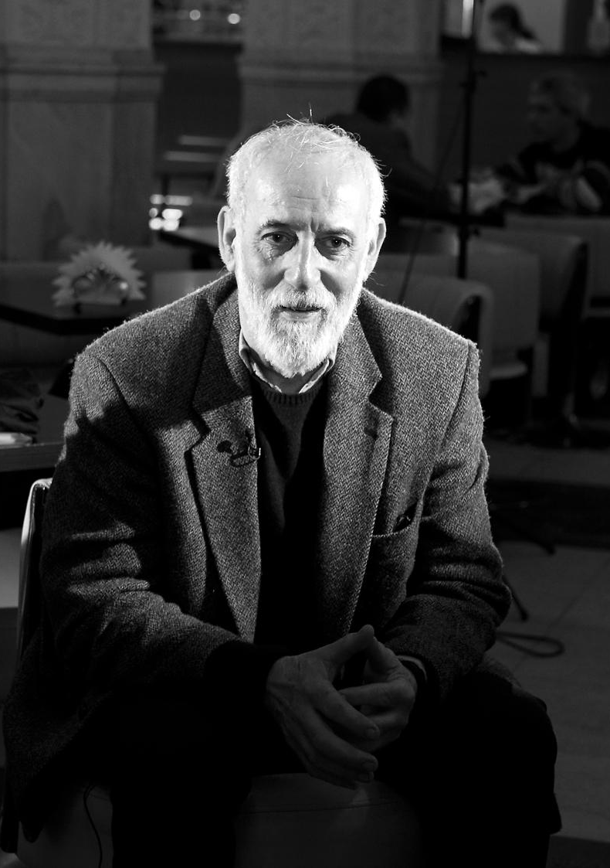
Lois Roth Award Honorable Mention
Donald Rayfield
Volume 1 of Kolyma Stories, by Varlam Shalamov
“I understood why people do not live on hope—there isn’t any hope. Nor can they survive by means of free will—what free will is there? They live by instinct, a feeling of self-preservation, on the same basis as a tree, a stone, an animal.”

Slide 61
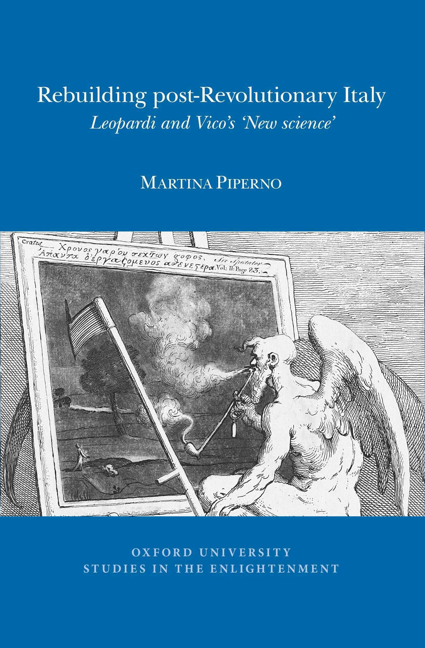
MLA Publication Prize Winners
10th Biennial
Aldo and Jeanne Scaglione Prize for Italian Studies

Slide 62

Aldo and Jeanne Scaglione Prize for Italian Studies
Martina Piperno
Rebuilding Post-revolutionary Italy: Leopardi and Vico’s New Science
I have always been curious about how literature and theory represent time. The postrevolutionary period in Italy is full of creative and interesting elaborations of time.

Slide 63
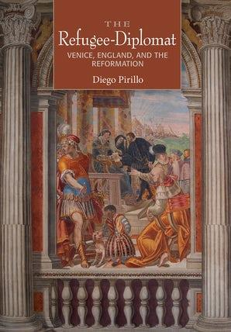
MLA Publication Prize Winners
10th Biennial
Aldo and Jeanne Scaglione Prize for Italian Studies

Slide 64
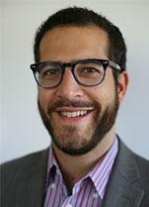
Aldo and Jeanne Scaglione Prize for Italian Studies
Diego Pirillo
The Refugee-Diplomat: Venice, England, and the Reformation
“[R]efugees were not merely intermediaries between states . . . they functioned as a parallel and alternative diplomatic network outside of formal channels, reproducing the authority of states, while also subverting it.”

Slide 65
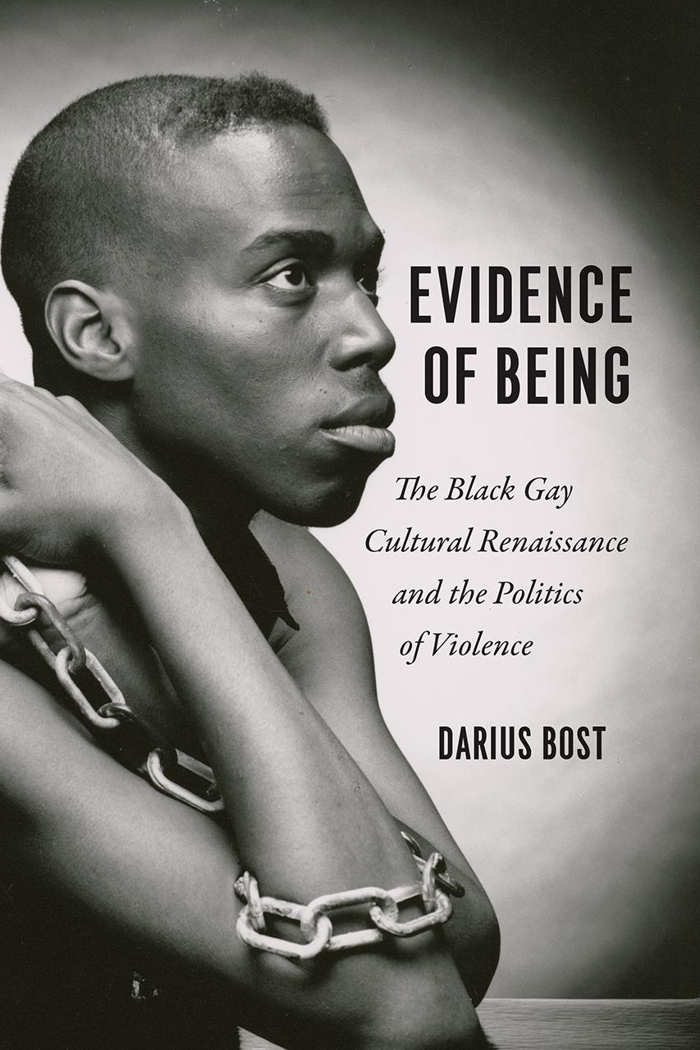
MLA Publication Prize Winners
18th Annual
William Sanders Scarborough Prize

Slide 66

William Sanders Scarborough Prize
Darius Bost
Evidence of Being: The Black Gay Cultural Renaissance and the Politics of Violence
Scholars often cite and anthologize the work of a few prominent figures of this period, but very little sustained critical attention has been paid to their individual works, and even fewer efforts have been made to contextualize the emergence of the cultural movement in which they took part.

Slide 67
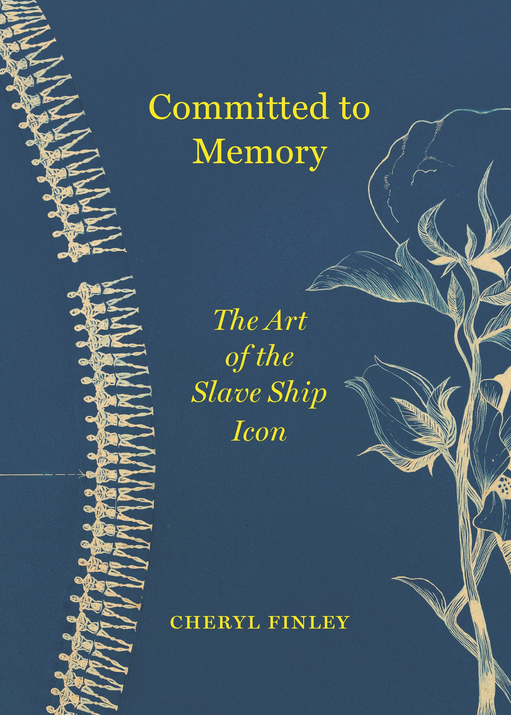
MLA Publication Prize Winners
18th Annual
William Sanders Scarborough Prize
Honorable Mention

Slide 68

William Sanders Scarborough Prize Honorable Mention
Cheryl Finley
Committed to Memory: The Art of the Slave Ship Icon
I first encountered the slave ship icon in a book in my family’s library when I was in grade school, Langston Hughes and Milton Meltzer’s A Pictorial History of the Negro in America: 1,000 Illustrations from Prints, Engravings, Photographs, Paintings, 1956.
Photo Credit: Gediyon Kifle

Slide 69

MLA Publication Prize Winners
18th Annual
William Sanders Scarborough Prize
Honorable Mention

Slide 70

William Sanders Scarborough Prize Honorable Mention
Cheryl A. Wall
On Freedom and the Will to Adorn: The Art of the African American Essay
“What is most significant about black oratory . . . is its complicated circuit of transmission: words were composed to be spoken, published to be read, and then often spoken aloud again as they were to audiences who could not read.”

Slide 71

MLA Publication Prize Winners
13th Biennial
MLA Prize in United States Latina and Latino and Chicana and Chicano Literary and Cultural Studies

Slide 72

MLA Prize in United States Latina and Latino and Chicana and Chicano
Literary and Cultural Studies
Stephanie Fetta
Shaming into Brown: Somatic Transactions of Race in Latina/o Literature
I found aesthetic recourse to bodies intriguing and confusing. I viscerally felt their power in signaling important social dynamics that left me feeling upset and uncomfortable—a productive place for theoretical inquiry.

Slide 73

MLA Publication Prize Winners
13th Biennial
MLA Prize in United States Latina and Latino and Chicana and Chicano Literary and Cultural Studies

Slide 74

MLA Prize in United States Latina and Latino and Chicana and Chicano
Literary and Cultural Studies
Licia Fiol-Matta
The Great Woman Singer: Gender and Voice in Puerto Rican Music
“In this book, I examine the reining in, ordering, correcting, or training of women’s ­vocal performances, but also the lines of flight opened up in these ­ per­for­mances, their écarts and silences.”

Slide 75

MLA Publication Prize Winners
13th Biennial
MLA Prize in United States Latina and Latino and Chicana and Chicano Literary and Cultural Studies
Honorable Mention

Slide 76

MLA Prize in United States Latina and Latino and Chicana and Chicano
Literary and Cultural Studies Honorable Mention
Leticia Alvarado
Abject Performances: Aesthetic Strategies in Latino Cultural Production
Thinking back to my time as an undergraduate majoring in studio art, I see in those student sculptures an early attempt to explore embodiment and abjection and through these the failure of strategies that center civility and respectability and therein the search for another way.

Slide 77

MLA Publication Prize Winners
4th Annual
Matei Calinescu Prize

Slide 78

Matei Calinescu Prize
Jane Elliott
The Microeconomic Mode: Political Subjectivity in Contemporary Popular Aesthetics
Through its signature combination of abstraction, extremity, and life-or-death decision, the microeconomic mode unites texts as divergent in audience and ambition as the Saw horror-film series, Cormac McCarthy’s novel The Road, the reality-TV franchise Survivor, and Steve McQueen’s film Hunger.

Slide 79

MLA Publication Prize Winners
4th Annual
Matei Calinescu Prize
Honorable Mention

Slide 80

Matei Calinescu Prize Honorable Mention
George Hutchinson
Facing the Abyss: American Literature and Culture in the 1940s
The 1940s seemed to me the black hole of American literary history—the largely unexamined pivot of the twentieth century, when abysses of meaning opened and summoned the powers of language to make sense of unprecedented experiences.

